Slide 1

Langholm Academy 2-18 School
P7 - S1 Transition 2025-26
A Barker – Depute Headteacher

Slide 2

Aims
Ensure a smooth transition for Primary to Secondary by;
Maintaining levels and pace of progress
Reducing anxiety and ensuring positive wellbeing
Maximising opportunities for success

Slide 3
Literacy, Numeracy, STEM and Health & Wellbeing mornings – Across Term 2 and Term 3
Health and Wellbeing
Numeracy
Literacy
STEM
SHANARRI
based activities
Team Problem Solving tasks
A range of
Literacy based group and individual activities
Science Lab activities
Led by Mr Ferris
Led by Mr McLean
Led by Mr Atkinson
Led by Miss Carruthers
Notes:
The sessions will run from 09:30 to 12:00. Canonbie pupils will be collected and returned to school. Langholm Primary pupils will be brought through and collected by P7 teacher. On first date pupils should bring their own snack. There will be opportunity for a tour of the school . Subsequent dates there will be opportunity to purchase from canteen prices Range from 30p for toast to £1.69 for a roll. Meal deals (roll, cake and drink) can also be purchased for £2.

Slide 4
Enhanced Transition
We will offer enhanced transition experiences for pupils who have Additional Support Needs as identified by their current primary schools.
This will be tailored to meet the needs of the pupils, once we know who has been allocated to Langholm academy

Slide 5
June Induction Days
Meet new friends
Meet teachers
Follow a secondary timetable
Learn the layout of the building
New canteen experience

Slide 6
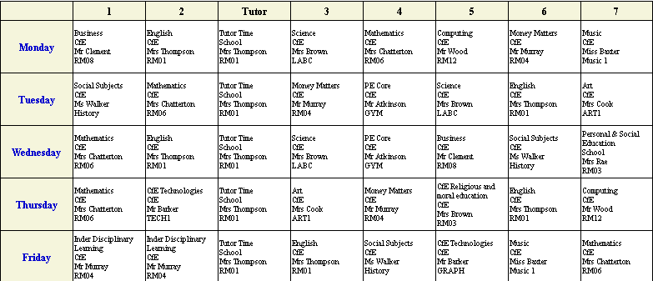
Example Timetable

Slide 7
Classes
Mixed Ability and made up of pupils from both Cluster Primaries as well as out of catchment placement requests
Non-Practical (S1/2 - max 33 S3 – max 30)
Practical – Science, HE, Design & Manufacture, Art, Graphic Communication, Computing (max 20)

Slide 8
Pupil Support
Pupils will be allocated to Esk, Tarras or Wauchope House
Pupils will have an allocated Pupil Support Teacher, Mrs Rae or Mr Ferris, who will be the first point of contact for both young people and parents/carers and any good news stories, achievements, worries or concerns should be shared with them in the first instance
Notes:
Do our best to ensure Langholm pupils will remain in current house. Placed in houses with siblings. Allocate a pupil support teacher Mrs Rae Tarras and half Wauchope. Mr Ferris Esk and half Wauchope. Should remain with them throughout their time at the academy and be first point of contact.

Slide 9
Uniform
Black trousers/shorts/skirt/leggings – no branding
White shirt (buttoned at the collar)
School tie (usually gifted to pupils from in-catchment Primary School)
Black Jumper (no brand names/logos)
School blazer (pupils measured during transition)
Black shoes/trainers (no coloured trims or logos)
Border Embroideries Website
Notes:
Hope to be able to arrange blazer fittings on one of the 3 transition days in June. Uniform Shop – order online.

Slide 10
PE Uniform
Black and red PE shirt (or non-football sports top/t-shirt)
Black and red hooded sweatshirt
Black shorts/leggings/tracksuit bottoms
Appropriate sports shoes
Border Embroideries Website

Slide 11
Mobile Phones
Should not be brought to the Academy on the transition mornings
May be brought on the 3 full induction days at parents’ discretion but will be responsibility of individual pupils and should not be used outside of break and lunch times
Can be brought to school from August at parents discretion but will be responsibility of individual pupils and should not be used outside of break and lunch times
Should not be used during the school day to ask parents to collect pupils if they feel unwell

Slide 12
Where to get information?
P7 teachers – still first point of contact
Mr Barker
Mr Ferris
Mrs Rae
School website
Facebook
Contact office 013873 80 418

