Slide 1
Higher Chemistry CfE
Langholm Academy
Unit 1
Chemical Changes and Structure

Slide 2
Higher Chemistry
Units
The Higher chemistry course is set out with the following units of work:
-Chemical Changes and Structures
-Nature’s Chemistry
-Chemistry in Society
These three units are taught individually and assessed through
Langhgolm Academy tests and SQA tests.
-Researching Chemistry
This unit is taught throughout the whole course. It is assessed through the skills you gain carrying out practical experiments and researching projects.
*The final exam is out of 120 marks and you will carry out an assignment (similar to National 5) that is worth 20 marks.

Slide 3
A. Controlling the Rate
-Reaction rates can be controlled by chemists. If they are too low a manufacturing process
will not be economically viable, too high and there is a risk of thermal explosion.
-Collision theory can be used to explain the effects of c____________, p______, s_____ area
(particle size), t__________ and collision geometry on reaction rates.
-A p________ e____ diagram can be used to show the energy pathway for a reaction. The
enthalpy change is the energy difference between products and reactants. It can be
calculated from a potential energy diagram. The enthalpy change has a n______ value for
exothermic reactions and a p________ value for endothermic reactions. The a__________
c_______ is an u________ arrangement of atoms formed at the maximum of the potential
energy barrier, during a reaction. The a_______ energy is the energy required by colliding
particles to form an activated complex. It can be calculated from potential energy
diagrams.
-A c________ provides an alternative reaction pathway with a l_______ activation energy. A
potential energy diagram can be used to show the effect of a catalyst on activation energy.
-Temperature is a measure of the average k______ energy of the particles of a substance. The activation energy is the m___________ kinetic energy required by colliding particles before reaction may occur.
-Energy d__________ diagrams can be used to explain the effect of changing temperature on
the kinetic energy of particles.
-The effect of temperature on reaction rate can be explained in terms of an i_________ in the
number of particles with energy greater than the a________________ energy.

Slide 4
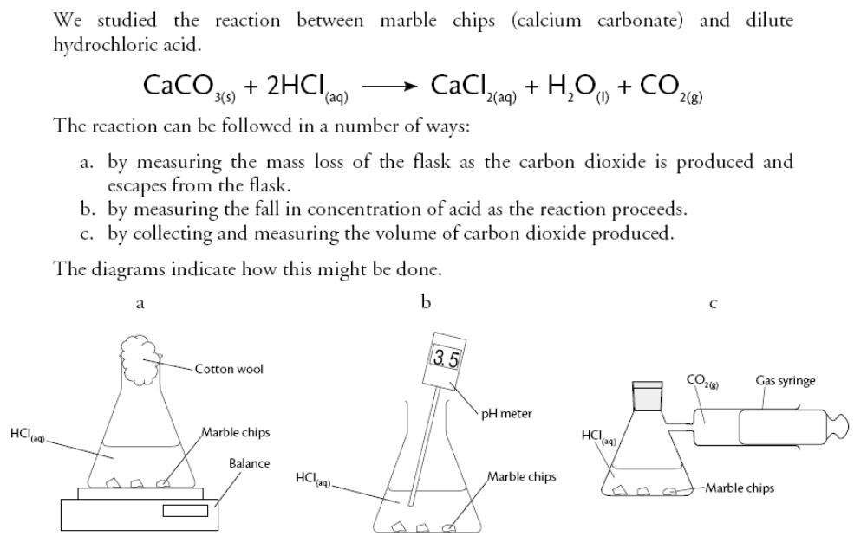
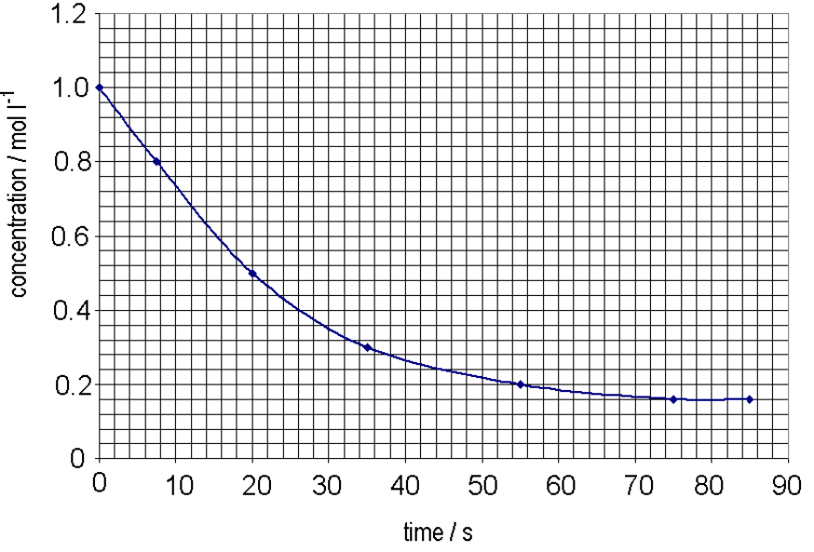
(i) Following the Course of a Reaction
Reactions can be followed by measuring changes in c_________, m____ and v________ of reactants and products.
1. Measuring decrease in mass (of flask)
Cotton wool
prevents spary
Mass of flask (g)
The graph indicates a steady d______ in
the mass of the flask as the gas e_______.
*Graph slope downwards.

Slide 6
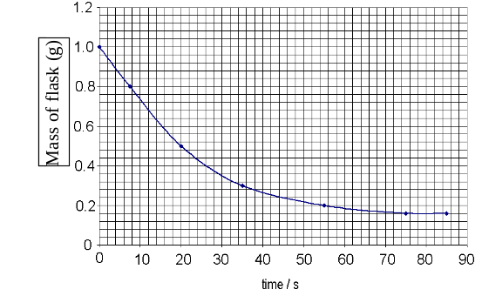

Slide 7
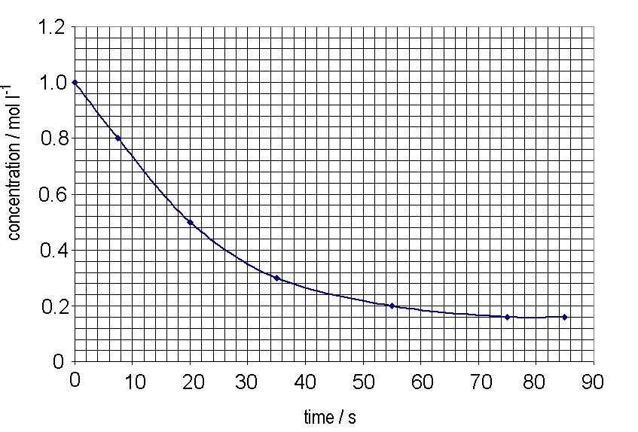
2. Measuring decrease in concentration (of acid)
When marble chips react with acid, the concentration of the acid steadily decreases.
*Graph slopes
downwards.

Slide 9
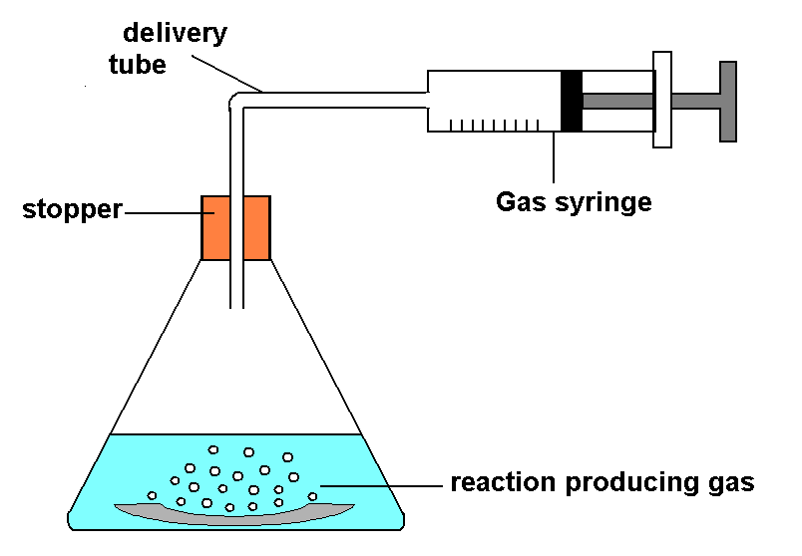
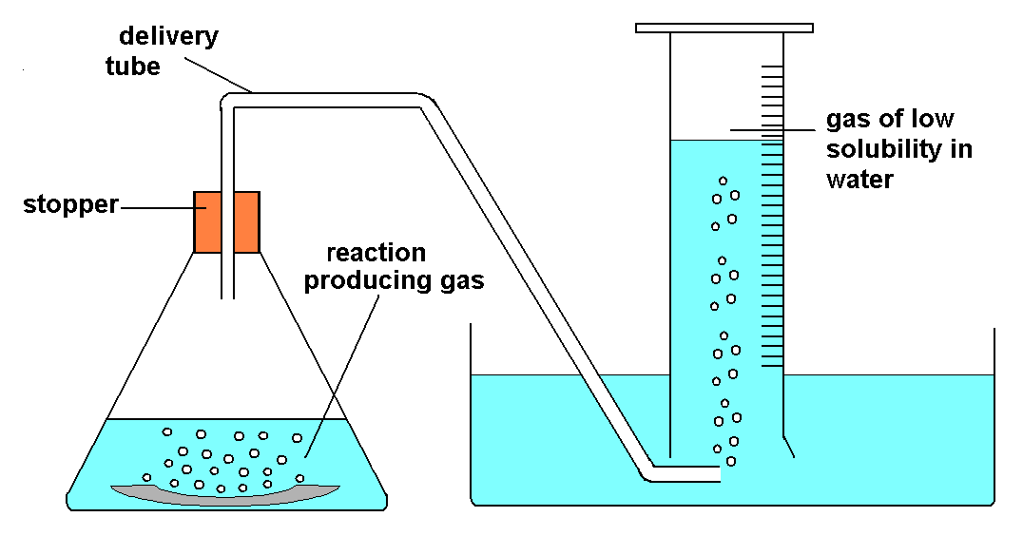
3. Measuring volume of gas produced
OR

Slide 11


Slide 12
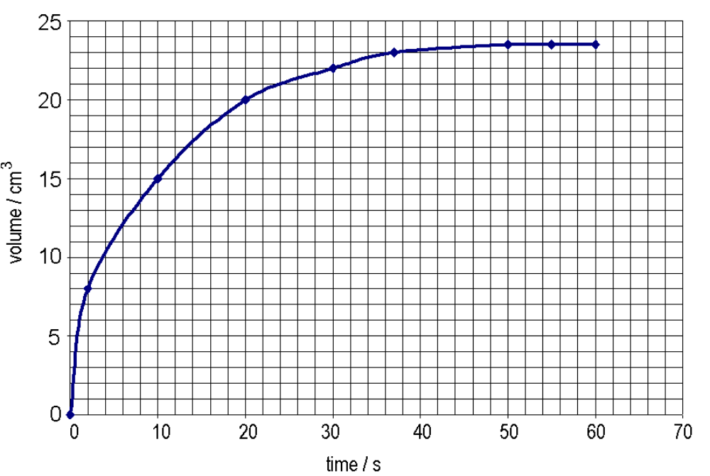
When a gas is collected, the graph below is a typical representation of what is obtained:
Reaction has _________
at this point.
The graph indicates a steady increase in the volume of gas produced as the reaction proceeds. Eventually __ _____ gas is produced and the reaction s_______.

Slide 14
(ii) Rate of Reaction
The average rate of a reaction can be calculated from measuring the change in variable and the time taken for the change to happen:
Rate = Change (in variable) Time taken for change
The unit of rate depends on the variable used, eg:
rate of change of c___________ (mol l⁻¹ s⁻¹),
rate of change of m____ (gs⁻¹)
rate of change of v_______ (cm³ s⁻¹)
(Kit list 1.1)

Slide 15
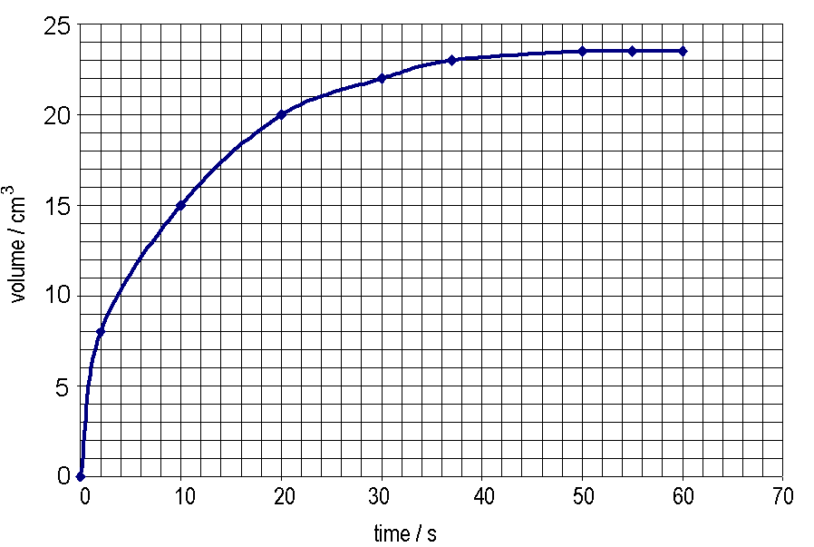
Example 1
Use the graph to calculate the rate of reaction for the first 10 seconds.
Use a ruler to mark on the graph
Rate = change
time
change = 0 – 15
= 15 cm³
= __
time = 10 seconds
= cm³ s⁻¹

Slide 16
Example 2
Use the graph to calculate the average rate of reaction for the first 26 seconds.
Rate = change
time
change = 1.0 - 0.4
= 0.6 mol l⁻¹
= _____
time = s
= mol l⁻¹ s⁻¹

Slide 17
Example 3
Use the graph to calculate the average rate between 8 and 74 seconds.
Rate = change
time
change = 0.8 – 0.16
= 0.64 mol l⁻¹
= 0.64
66
time = 74 - 8 s
= 66s
= 0.0097 mol l⁻¹ s⁻¹
= 9.7 x 10⁻³ mol l⁻¹ s⁻¹

Slide 18
Example 1
Example 2
Example 3

Slide 19
Example 4
5 grams of calcium carbonate was added to 25 cm³, mol l⁻¹ hydrochloric acid. After 30 seconds the calcium carbonate was removed washed, and dried. The mass of the calcium carbonate was found to be 3.5 grams. Calculate the rate of reaction.

Slide 20

Finding the Rate Using Time Only
For some reactions, a ___________ change will indicate the end of the reaction.
e.g. From colourless to blue / black
The only measurement recorded during this type of reaction is time. As there is no change in variable, the rate is expressed as:
Rate = 1 .
time
The unit of rate here is _______

Slide 21
Example 5
Use the information in the table to calculate the rate of reaction at 40°C and 60°C, respectively.
Temp (°C) | Time (s)
40 | 35
60 | 12

Slide 22
Example 6
(Calculating time from rate)
Consider the graph below taken from an experiment which alters the
volumes of reactant.
Using R=1/t
0.025
0.02
0.015
Rate (s-1)
Series1
0.01
0.005
0
0
2
4
6
8
10
Volume of reactant (cm3)
Calculate the time taken for the reaction to finish when the volume of
reactant used is 8cm^{3.}

Slide 23
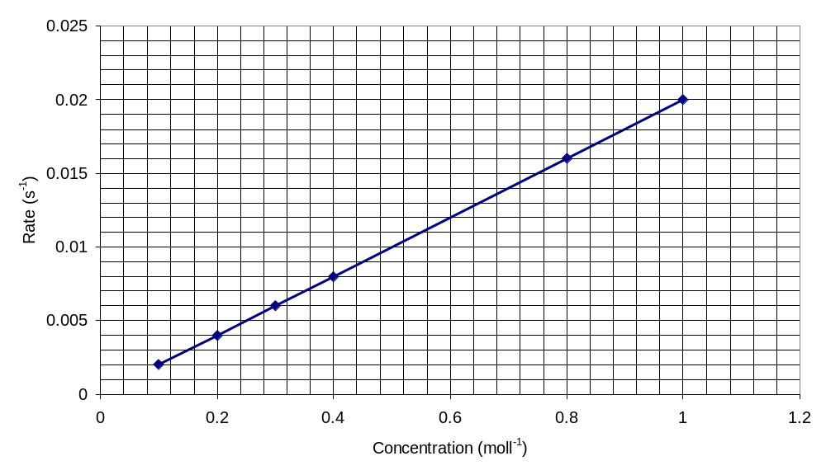
Example 7
Use the graph to calculate the time taken for the reaction when a concentration of 0.6 mol l⁻¹ is used.

Slide 25
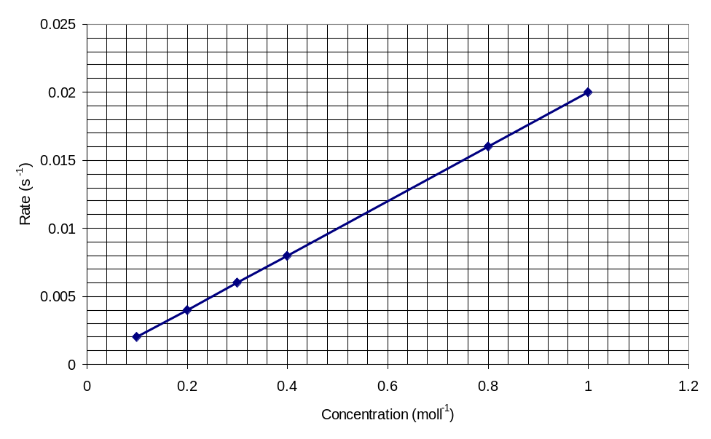
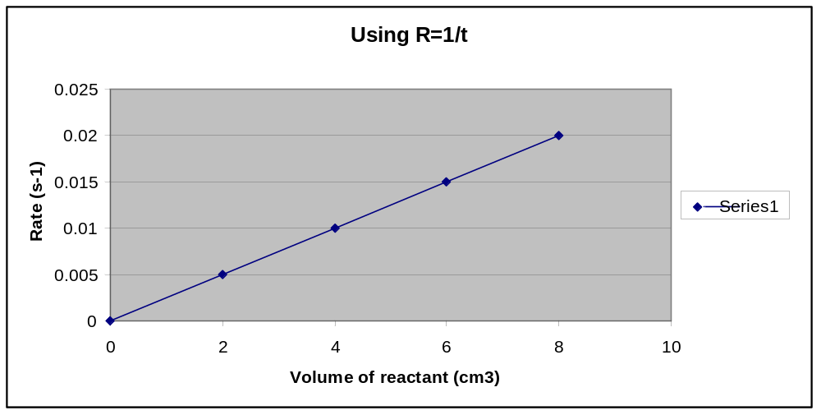
Example 6
Example 7

Slide 26
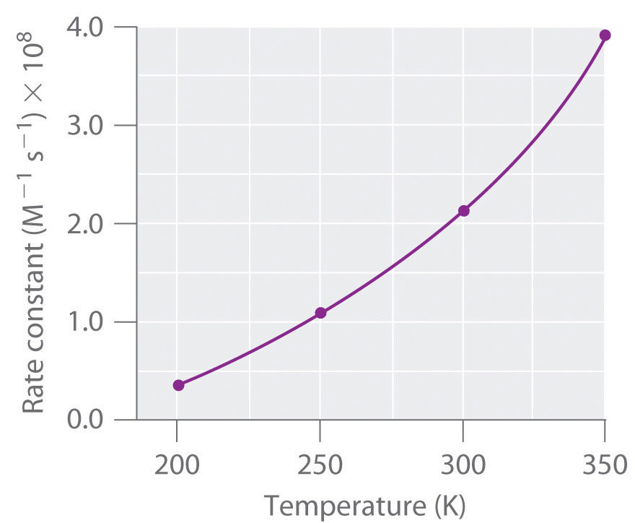
Both temperature and concentration of reactants can influence the rate of reaction
An increase in both variables leads to an increase in reaction rate
However, a ________ increase in temperature leads to a ________ increase in the rate
of reaction
Typical graphs:-
Rate (s⁻¹)
Rate (s⁻¹)
Concentration (mol l⁻¹)

Slide 27
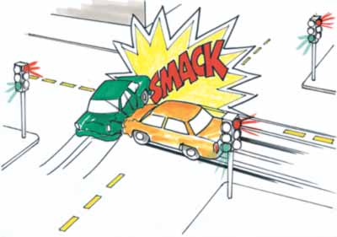
(iii) Factors Affecting Reaction Rate-Collision Theory
For a chemical reaction to occur, reactant particles must ________ with enough ________ to react.
It is important for chemists to have a clear understanding about rates of reaction. This means they can produce more chemicals in a shorter time and also slow down extremely fast reactions which could potentially explode.
The following factors can alter the number of _________ __ collisions during a chemical reaction and thus increase the reaction rate:
-Concentration
-Pressure
-Particle size
-Collision geometry
-Temperature

Slide 28
1. Concentration
Increasing the concentration of a solution:
Increases the number of particles in a given volume.
More particles will result in a greater _______ of successful collisions
Therefore __________ reaction rate.

Slide 29
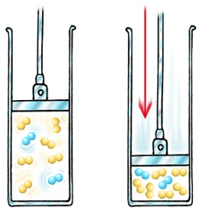
2. Pressure
Increasing the pressure of a reaction:
Increases the number of particles in a given volume.
More particles will result in a _________ chance of successful collisions
Therefore ____________ reaction rate.

Slide 30
3. Particle Size
Reactions of solids can only take place at the surface of the solid.
-Smaller particles have a larger surface area.
Larger surface area will result in a _______ chance of successful collisions
-Therefore __________ reaction rate.
4
4
10

Slide 31
4. Collision Geometry
Reactant particles must strike each other at the _______ angle for a product to form.
H
H
The bromine molecule collides at an angle not close to the carbon to carbon double bond, i.e. no reaction will occur.
C
H
C
C
Br-Br
H
H
H
Br-Br
The bromine molecule collides with the alkene at an angle favourable to strike the carbon to carbon double bond, i.e. a product will form as the collision will have been successful.
H
H
C
H
C
C
H
H
H

Slide 32
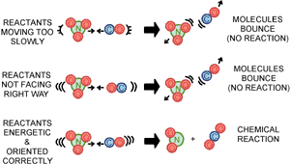

Slide 33
5. Temperature (and activation energy)
T____________ is a measure of the ____________________ of the particles in a substance. Energy _____________ diagrams (Boltzmann distribution) are used to show the distribution of kinetic energy that particles have in a substance.
T₁
Particles with ___________ energy for successful collisions.
Number of
________
T₁ + 10°C
____________ energy
E_{A}
(_______________ Energy)
Particles with enough energy for successful collisions.
For T₁ + 10°C there are more particles with energy equal to or greater than activation energy than at T₁.

Slide 34
*E_{A} Activation energy,
is the minimum kinetic
energy that particles need
before they can react.
T
1
Number of
Number of
particles
T
+ 10
°
C
particles
1
Kinetic energy
E
Kinetic energy
A
(Activation Energy)
- Heating particles gives them _______ energy.
- This causes an ________ in the number of particles with energy greater
than or equal to the _____________ energy.
This will result in a ____________ chance of successful collisions.
Therefore ___________ reaction rate.
*Animation

Slide 35
In a chemical reaction, a _______ rise in temperature results in a ____
increase in rate.
Rate
Rate
temperature
For some chemical reactions, a rise in temperature of _____°C
approximately doubles the rate of reaction.

Slide 36
(iv) Reactants in Excess
Calcium carbonate can react with excess (more than enough)
hydrochloric acid according the equation:
The reaction can be followed by collecting the volume of CO₂ produced.
2 mol l⁻¹ HCl
Volume
CO₂
(cm³)
Rate of reaction increases
using 2 mol l⁻¹ HCl.
1 mol l⁻¹ HCl
Time/s

Slide 37
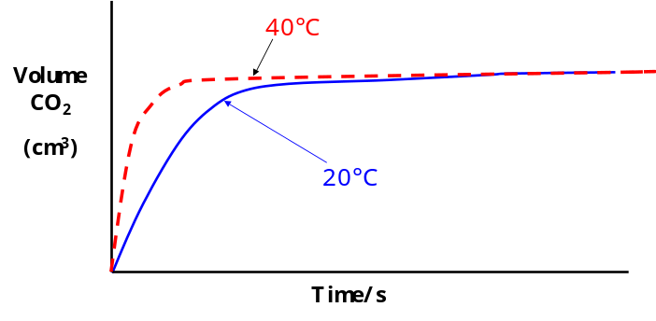
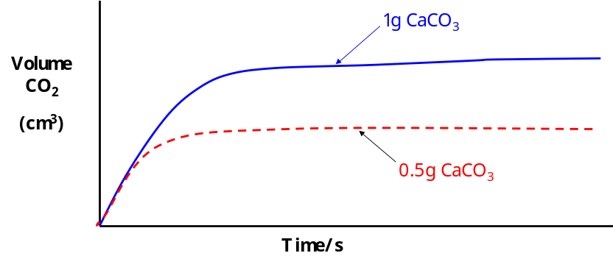
The rate of CO₂ produced can be monitored by altering other variables.
CaCO
powder
Rate of reaction ________ using powder.
3
Volume
CO
2
(cm
)
3
lumps
CaCO
3
Time/s
Rate of reaction __________ using a higher reaction temperature.
The final volume of CO₂ produced is
half because the initial of CaCO₃
used is _______.

Slide 38
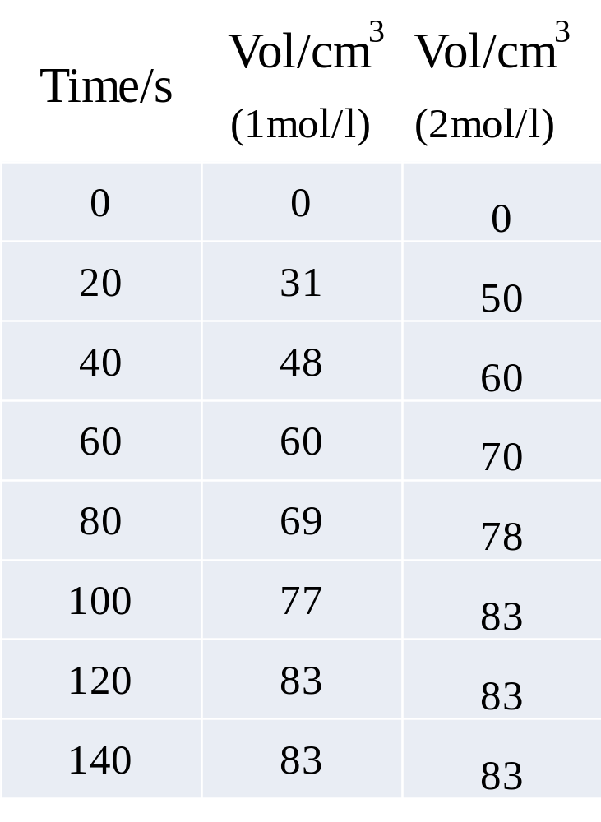
Use the following data to
draw a graph of the results

Slide 39
The experiment that uses acid with a concentration of 2mol/l has a
_____________ rate of reaction.

Slide 40
Experiment 1.1 Effect of Concentration on Reaction Rate
Aim:
To find the effect of varying concentration of potassium iodide on the rate of its
reaction with hydrogen peroxide.
Procedure:
The time taken for the
blue/black colour to appear
depends on the concentration
of the iodide ions. The colour
changes because the iodine
molecules react with the starch
solution. This colour change is
sharp and therefore appropriate
for measuring the rate of
reaction.
Hydrogen peroxide (H₂O₂) was added to different concentrations of potassium iodide
and the time was measured for the colour change to occur, i.e colourless to blue/black.
(Kit list 1.3/1.4)

Slide 41
Results
Vol KI/cm³ | Vol. water/cm³ | Time/s | Rate=1/t (s⁻¹)
25 | 0 | 23
20 | 5 | 29
15 | 10 | 39
10 | 15 | 60
5 | 20 | 111
*The concentration of potassium iodide (KI) is gradually decreased in each
experiment by adding water. Note that the total volume of KI and water combined is
always _______ in each set of experiments. This makes sure the concentration of the
________ reactants is constant and makes a fair test.

Slide 42
0.05
0.045
0.04
0.035
0.03
Experiment 1.1
Rate (i/t)/ s-1
0.025
0.02
0.015
0.01
0.005
0
5
10
15
20
25
Volume of KI/ (cm3)
Conclusion
As the concentration of potassium iodide _____________ the rate __________.

Slide 43
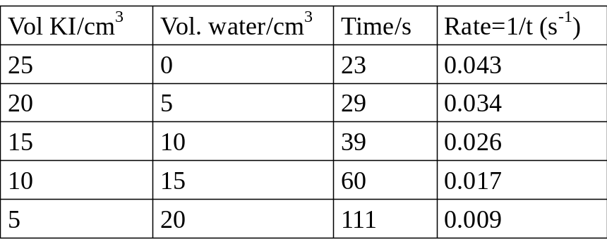

Slide 44
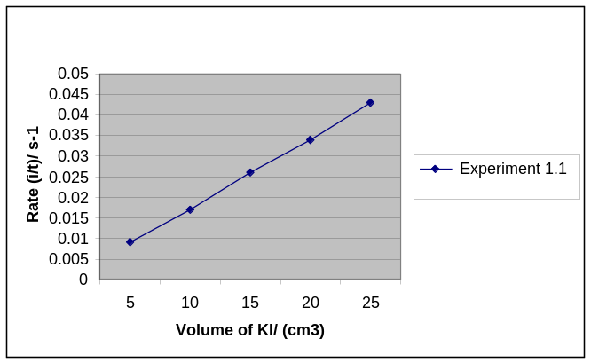

Slide 45
Experiment 1.2 Effect of Temperature Change on Reaction Rate
Aim:
To find the effect of varying _____________ on the rate of reaction between _______
acid (C₂H₂O₄) and acidified _______________________________.
Procedure:
The rate of the reaction was
measured by timing how long
it took the solution to change
from _____________________.
Oxalic acid
The experiment was carried out
four times at different temperatures.
Acidified potassium permanganate
(purple due to MnO₄⁻ ion)
The _____________ and ___________ of the reactants were kept constant in order to make it a fair test. To ensure this was the case the beaker was well ______before each experiment.
(Kit list 1.2)

Slide 46
Results
The rate of each experiment is calculated using:
Rate = 1
Time
Experiment | Temperature/°C | Time (t)/s | Rate (1/t)/s⁻¹
1 | 38 | 87
2 | 50 | 35
3 | 59 | 18
4 | 70 | 8

Slide 47
A graph of rate against temperature can be calculated:
0.14
0.12
0.1
0.08
Rate (1/t) s-1
0.06
0.04
0.02
0
30.00
35.00
40.00
45.00
50.00
55.00
60.00
65.00
70.00
75.00
Temperature/0C
Conclusion
As the temperature increases the rate of reaction increases. In some cases, a _____ increase can ________ the rate of reaction.
Evaluation
The experiment is not carried out at room temperature because the colour change is ______ gradual and not accurate enough.

Slide 48
(v) Catalysts
The use of a catalyst can also __________ the rate of a chemical reaction.
Catalysts _________ the rate of reaction without being _______ up and allow a reaction to occur at a lower temperature because:
A catalyst ____________ the
ACTIVATION ENERGY
of a reaction.
(Kit list 1.5)

Slide 49
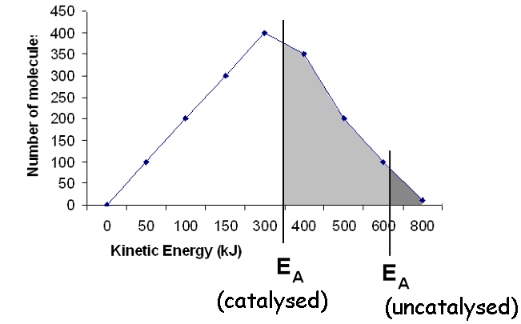
Energy Distribution and Catalysts
Using a catalyst:
- causes _______ particles to have energy ______ to or ________ than the Activation Energy value.
results in _______ successful collisions.
_________ the rate of reaction.

Slide 50
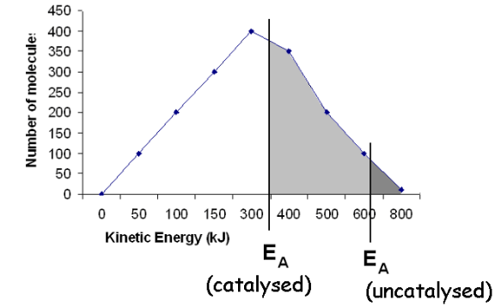

Slide 51
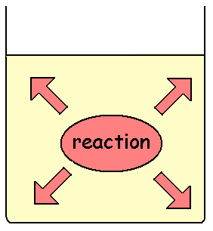
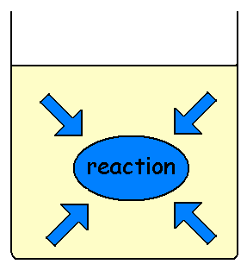
(vi) Potential Energy Diagrams
A potential energy diagram can be used to show the energy pathway for a reaction. These diagrams indicate if a reaction is exothermic or endothermic.
Exothermic – energy is given _____ to the surroundings
chemical energy → heat energy
i.e. the temperature of surroundings ___________.
Endothermic energy is ________ from the surroundings
heat energy → chemical energy
i.e. the temperature of surroundings ___________.
(Kit list 1.6)

Slide 52
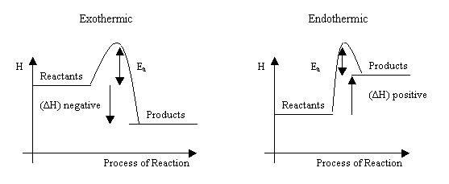
During a reaction bonds are broken and new bonds are formed.
Reactants Products
(Bonds _________)
(Bonds _______)
Energy is required to break bonds (___________) and energy is released (____________) when new bonds are made.
The difference in energy between the products and reactants is called the enthalpy change, ΔH.
ΔH = energy of products – energy of reactants

Slide 53
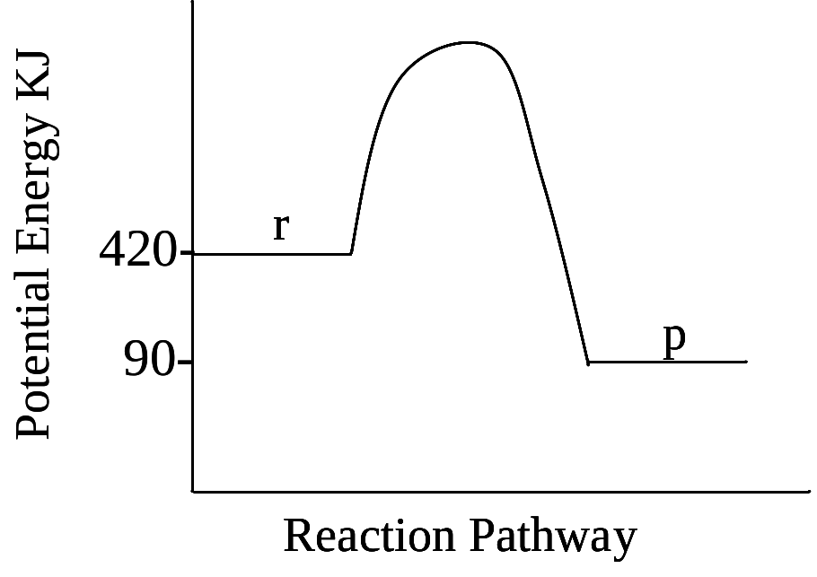
Calculating Enthalpy-Exothermic Reaction
ΔH = energy of products – energy of reactants
=
= kJ mol ⁻¹
*Exothermic enthalpy changes are always ____________.

Slide 54
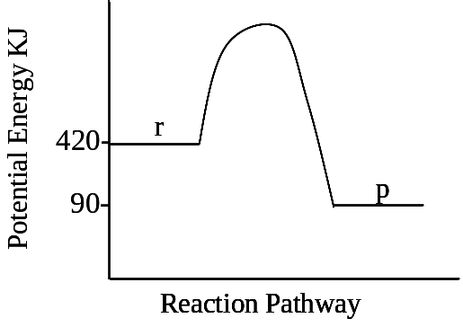

Slide 55
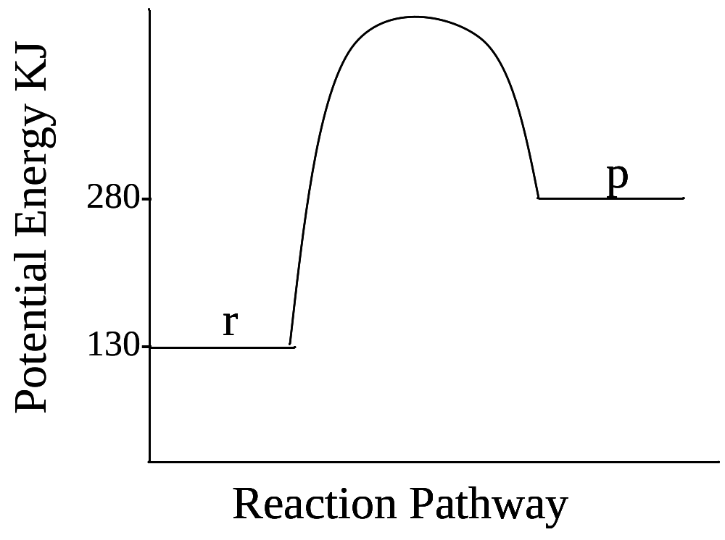
Calculating Enthalpy-Endothermic reaction
ΔH =
= kJ mol ⁻¹ or kJ mol ⁻¹
*Endothermic enthalpy changes are always ________________

Slide 56
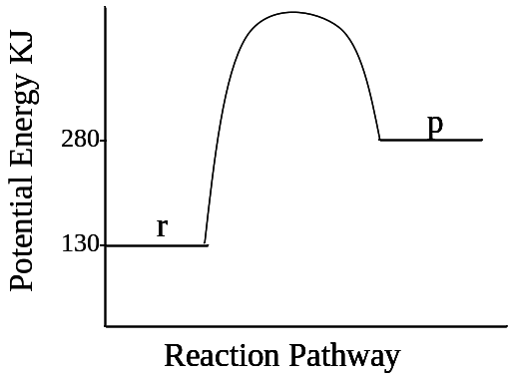

Slide 57
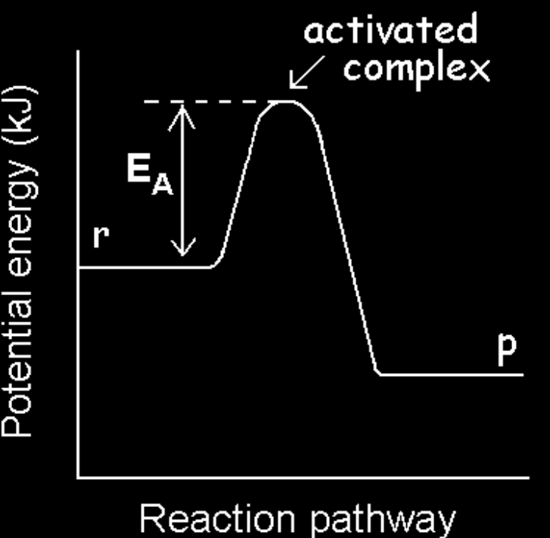
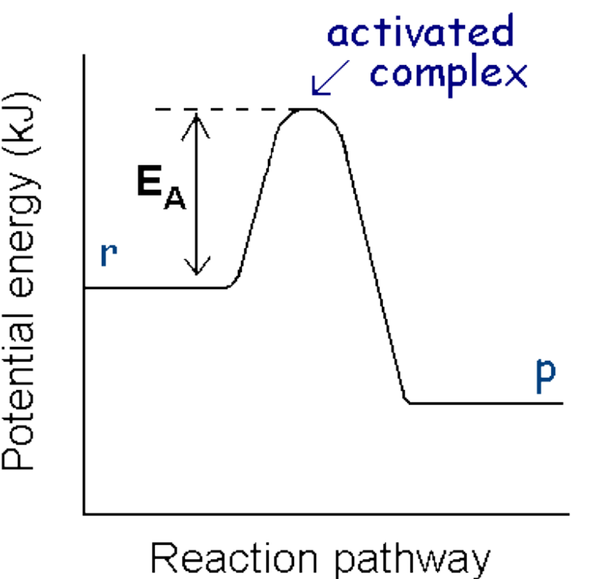
The ________ energy, E_{A} , can be described as an “energy barrier.” It is the energy that the reactant particles must overcome in order to form the product. It is the energy required by colliding molecules to form an _______________ (maximum point on the diagram).
r → p
E_{A} of the forward reaction:

Slide 58
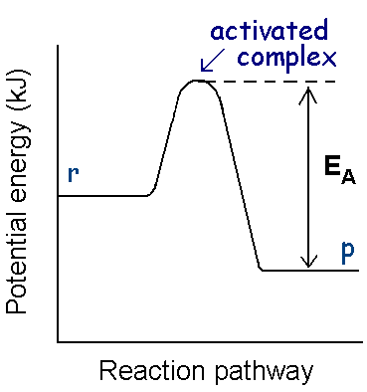
Or, E_{A} of the reverse reaction:
p → r

Slide 59
Activated complex
Definition: The activated complex is an _______ arrangement of atoms formed as reactant bonds are broken and product bonds are formed. It occurs at the _____________ point of the potential energy diagram.
A
B
Reactants
+
A
B
A
B
A____________ complex
A
B
A
B
Products
+
A
B

Slide 60
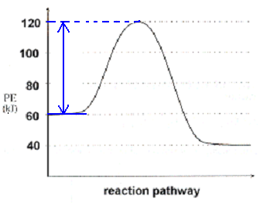
Example 1
Calculate the activation energy for the forward reaction (E_{A} forward).

Slide 61
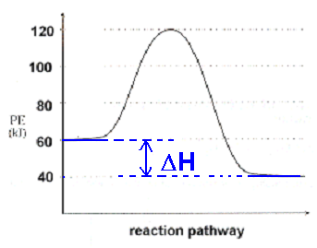
Example 2
Calculate the enthalpy change for the forward reaction (ΔH forward).

Slide 62
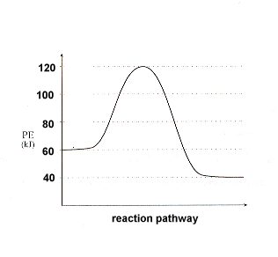
Example 1
Example 2

Slide 63
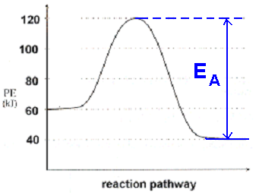
Example 3
Calculate the activation energy for the reverse reaction (E_{A} reverse).

Slide 64
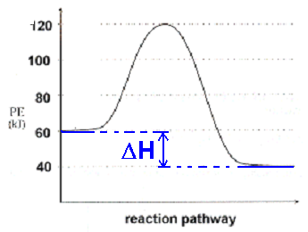
Example 4
Calculate the enthalpy change for the reverse reaction (ΔH reverse).

Slide 65
Example 3
Example 4

Slide 66
Conclusions
Activation energy for forward and reverse reactions will always be ________________.
Enthalpy change for forward and reverse remains constant apart from the ________ (+/-).
Rate of reaction does ______depend on ΔH enthalpy change.

Slide 67
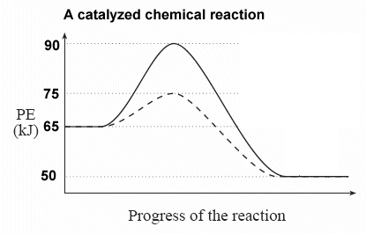
Using a catalyst
A catalyst will provide an alternative reaction pathway that involves less energy. Therefore, a catalyst lowers the activation energy of a reaction. A catalyst however, alter the enthalpy change ΔH of the reaction.
Reaction ________ a catalyst (_____ E_{A})
Reaction _____ a catalyst (_____ E_{A})
*Enthalpy change (____), is the same for both reactions.
(Kit list 1.7)

Slide 68
Example 5
Calculate the activation energy of the uncatalysed reaction:
Example 6
Calculate the activation energy of the catalysed reaction:

Slide 69
Example 5
Example 6

Slide 70
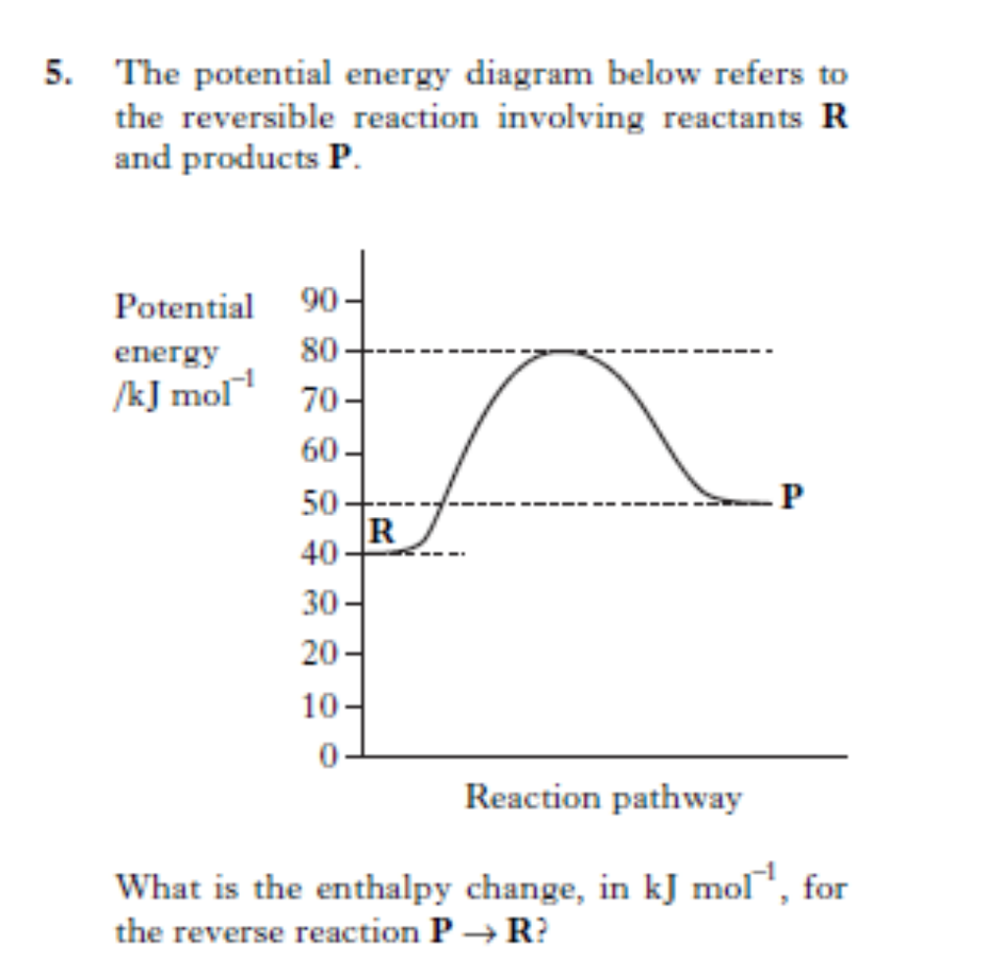

Slide 71
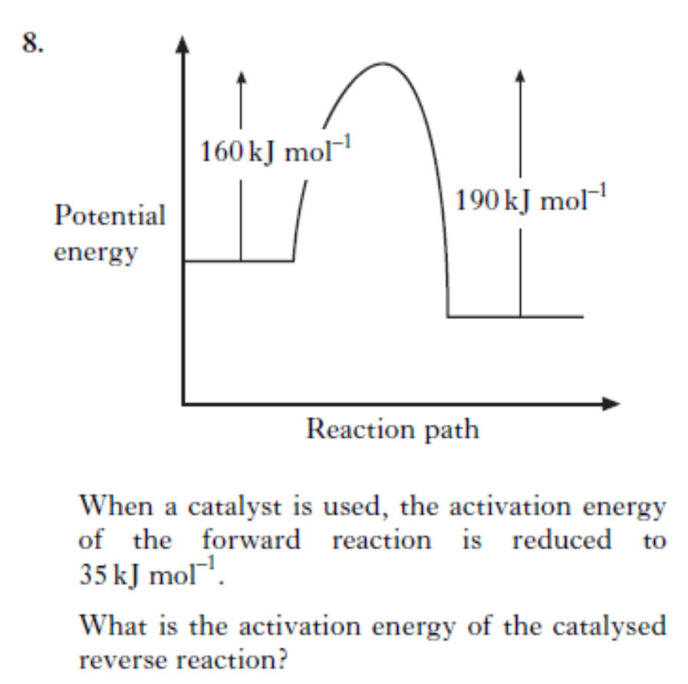

Slide 72
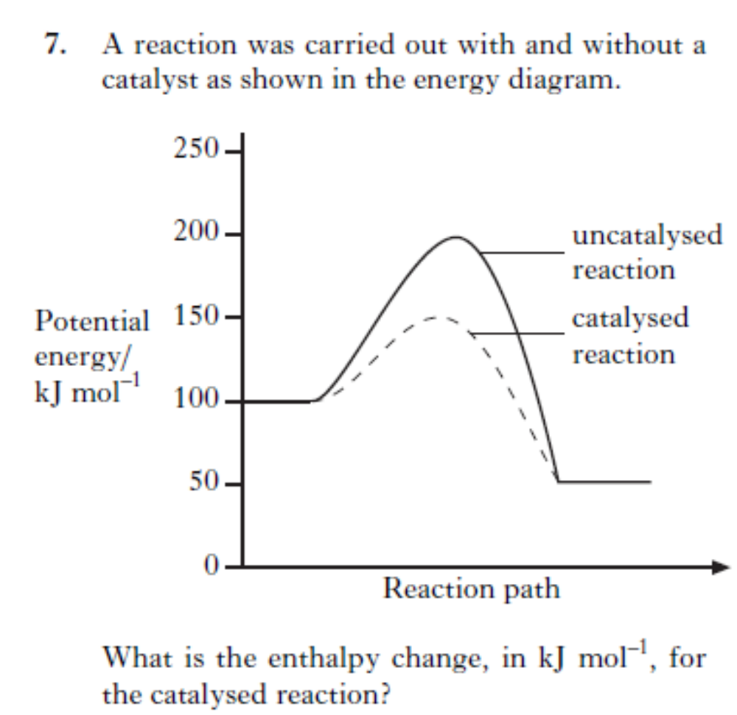

Slide 73
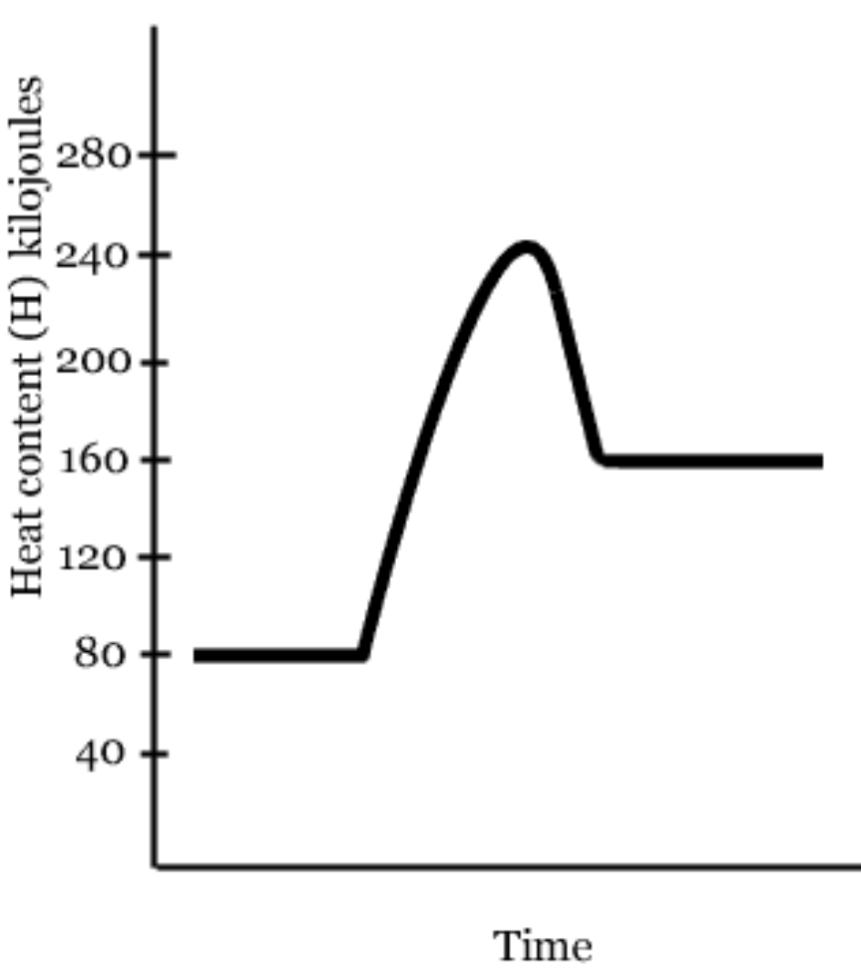
Lesson Starter
-Calculate the enthalpy change (∆H) of the forward reaction.
-Is the reaction exothermic or endothermic?
-Calculate the activation energy of the forward reaction
-What is the energy of the activated complex?

Slide 74
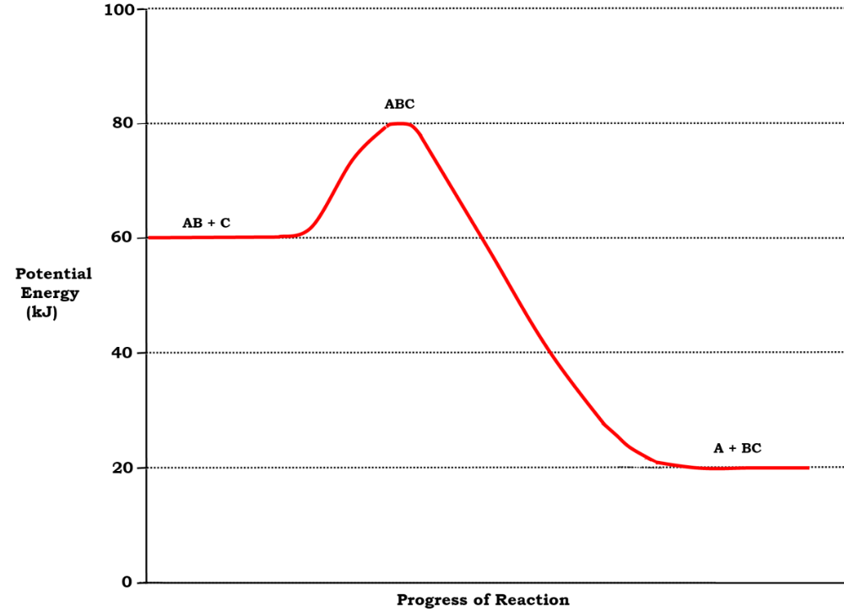
-Calculate the enthalpy change (∆H) of the reverse reaction.
-Calculate the activation energy of the forward reaction.
-Calculate the activation energy of the reverse reaction.

Slide 75
B. Periodicity-Trends In The Periodic Table
-Elements are arranged in the Periodic Table in order of increasing ________ number. The
Periodic Table allows chemists to make accurate predictions of physical properties and
chemical behaviour for any element based on its position.
-The first ____ elements in the Periodic Table can be categorised according to bonding and
structure:
♦ _________(Li, Be, Na, Mg, Al, K, Ca)
♦ ________ ____________(H₂, N₂, O₂, F₂, Cl₂, P₄, S₈ and fullerenes (eg C₆₀))
♦ ____________ ___________ (B, C (diamond, graphite), Si)
♦ _______________ (_________ gases)
-The covalent radius is a measure of the _____ of an atom. The trends in covalent radius across
periods and down groups can be explained in terms of the number of __________shells, and the _______ ______.
-The trends in ionisation energies across periods and down groups can be explained in terms
of the _______ ______, ________ charge and the _______ effect due to inner shell electrons.
-Atoms of different elements have different attractions for bonding electrons. Electronegativity
is a measure of the attraction an atom involved in a bond has for the electrons of the bond.
E_____________ values _________ across a period and __________ down a group.
Electronegativity trends can be rationalised in terms of _________ charge, covalent ______ and the presence of ‘____________’ inner electrons.

Slide 76
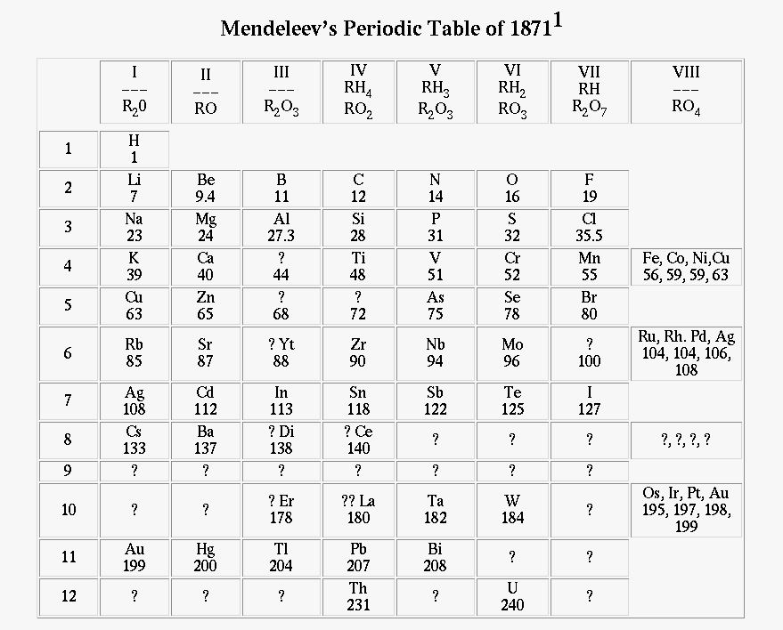
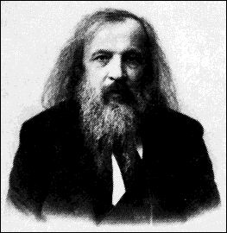
The Periodic Table
During the 19th Century many
scientists tried to group the
elements that were then known.
However, it wasn’t until 1869 that Dimitri Mendeleev (a Russian scientist) made
real progress towards constructing a Periodic Table.

Slide 77
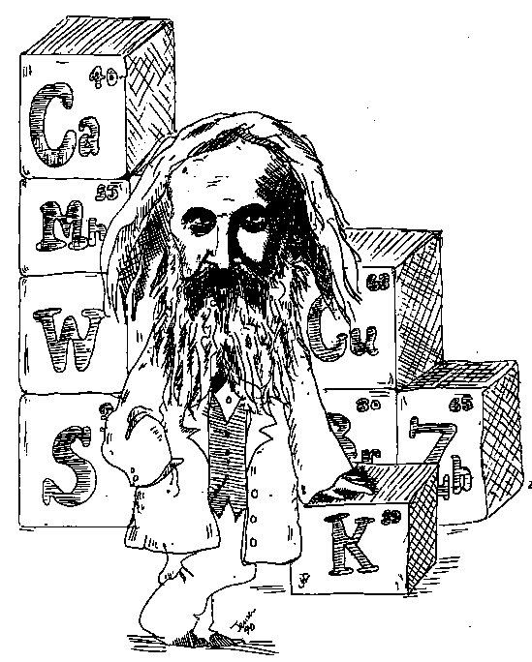
Mendeleev’s Main Findings
-The elements have a trend of similar
properties if they are arranged in order
of increasing atomic number.
-The elements were arranged vertically
and horizontally. In this arrangement they
were referred to as _______ and _________.
-The groups of elements all had _________
chemical properties.
-Blanks were left for elements that weren’t
yet found. Mendeleev was able to predict
the properties of some of these elements that weren’t
yet found. It was later discovered that his predictions
were accurate.

Slide 78
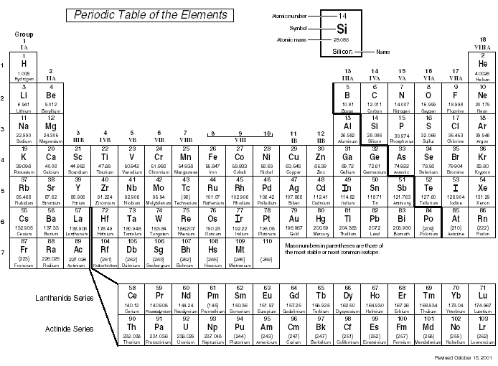
The following three properties will be considered:
B. Periodicity-Trends In The Periodic Table
P___________
Atomic size
(covalent radius)
G
2. Ionisation energy
3. Electronegativities
When looking at these three properties, it is appropriate to consider their trends going across a period of elements and down a group of elements.

Slide 79
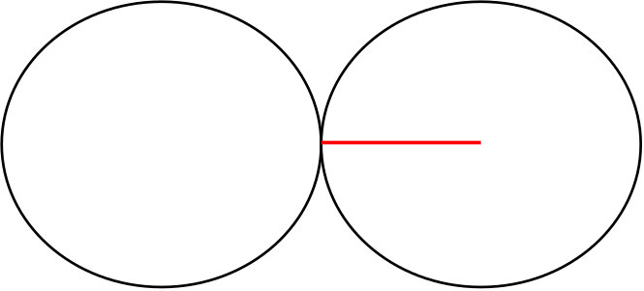
(i) A Size (Covalent R )
The atomic size of an atom is a measure of the covalent radius, which
is half the distance between the nuclei of two bonded atoms of an element.
covalent radius
Information on the covalent radius of selected elements can be found on
page 7 of the data booklet.
e.g. the covalent radius of hydrogen is 37pm
pm = picometre (1 x 10⁻¹²m or 0.000000000001 metres)

Slide 80
Using the information on page 7 of the data booklet find the covalent radius for:
Group 1 elements Lithium → Rubidum
Group 2 elements Beryllium → Strontium
Period 2 elements Lithium → Fluorine
Period 3 elements Sodium → Chlorine
Having gathered the data above, what conclusions have you been able to arrive at?

Slide 81
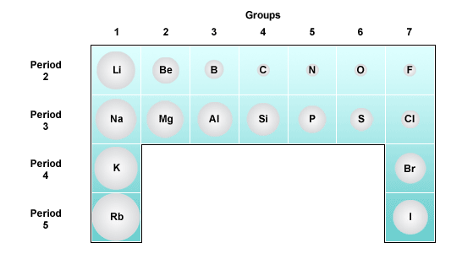
Across a Period
The covalent radius of atoms _______ as we go across a period because
of the ________ positive nuclear charge. There is a greater __________
between the increasing number of protons and electrons.
The nucleus pulls the energy levels/shells _______ towards the nucleus.

Slide 83
Consider the atomic size for Li → F
Li Be B F
3+
4+
5+
9+
The atomic size _________ as the nuclear charge ________. Note also
that the number of electron shells remains the same.

Slide 84
Down a group
The covalent radius of atoms _______ as we go down a group because there are _______ energy levels/shells.
e.g. Li→ Cs
Although the nuclear charge increases down a group the outermost electrons are __________ (“screening effect”) by the inner electrons. Therefore the increasing nuclear charge has _______ effect on the outer electrons.
Li
3+
Na
11+
Cs
55+

Slide 85
(ii) Ionisation Energy
Ionisation energy is the energy required to _________ one mole of electrons from one mole of gaseous atoms.
The first ionisation energy for sodium is:
Na_{(g)} → Na⁺_{(g)} + e⁻
+496 KJ mol ⁻¹
(page 11 of data booklet)
electron removed
This is an __________
reaction as energy is
“put in” to pull an
electron away from the
outer shell of an atom.
Na

Slide 86
Using the information on page 11 of the data booklet find the first ionisation energies for:
Group 1 elements Lithium → Caesium
Period 2 elements Lithium → Neon
Having gathered the data above, what general trends have you observed?

Slide 87
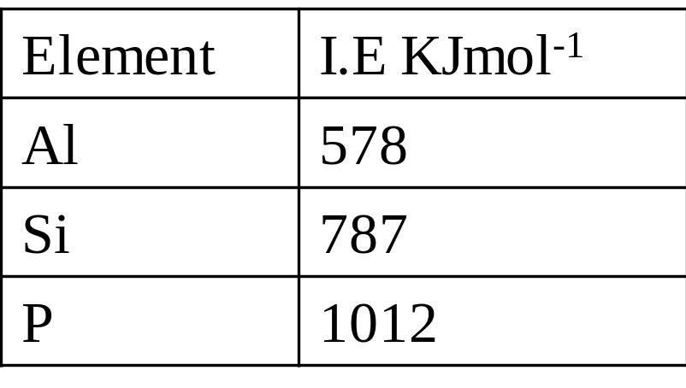
Across a Period
The ionisation energy ________ going across a period.
e.g. Al → Si → P
As the positive nuclear charge is increasing across a period, the attraction the nucleus has for the electrons also increases. Electrons are closer to the nucleus and therefore more difficult to remove. As a result more energy is required to remove an electron.

Slide 88

Down a Group
The ionisation energy _________ going down a group.
The outer shell is furthest from the nucleus therefore the attraction from
the nucleus on the outer electrons is smaller. As a result, less energy is
required to remove an outer electron.
In addition, the electrons from each new energy level going down a
group of elements will be “shielded” by the inner electrons (screening
effect). This also means the outer electrons are less attracted to the
nucleus and easier to remove.

Slide 89
Second Ionisation Energy
This is the energy required to remove a second electron from an ion in the gaseous state.
e.g. Na⁺_{(g)} → Na ²⁺_{(g)} + e⁻
electron removed
Na⁺
Na²⁺

Slide 90
Successive ionisation energies can correspondingly be represented.
The third ionisation energy of sodium can be represented as:

Slide 91
The first, second, third and fourth ionisation energies of sodium are shown in the table below:
Number of Ionisation energy | Energy KJ mol⁻¹
1st
2nd
3rd
4th
Successive ionisation energies increase because the electrons get ______
to the nucleus. Due to this, there is a stronger attraction between the
electrons and the nucleus. As a result, more energy is required to remove
each successive electron.
*Notice that there is a _______ increase between the first and second
ionisation energies of sodium. This is because the second ionisation
energy is removing an electron closer to the nucleus. There is a stronger
attraction and as a result more energy is needed to remove this second
electron.

Slide 92
(iii) Electronegativity
Electronegativity is a measure of the ability of an atom to ________ electrons in a _________ bond.
An atom with a high electronegativity will tend to attract bonded
electrons towards it.
Consider a molecule of hydrogen chloride.
As chlorine is more electronegative than hydrogen it has a greater share
of the bonding electrons. This creates a _________ bond.

Slide 93

Across a Period
Electronegativity __________ across a period. There is an increase in the
positive _________ charge across a period and this causes the atom to
attract bonded electrons more strongly.

Slide 94
Down a Group
Electronegativity _______ down a group. An increase in the number
of electron shells causes the bonding electrons to be less attracted to
the positive _________ charge. As the electrons are less strongly
attracted, the electronegativity __________.

Slide 96
C. Structure and Bonding
-In a covalent bond, atoms _______ pairs of electrons. The covalent bond is a result of two
positive nuclei being held together by their common attraction for the _______ pair of
electrons.
-P_______covalent bonds are formed when the attraction of the atoms for the pair of bonding
electrons is different. Delta _______ and delta ______ notation can be used to indicate the
partial charges on atoms, which give rise to a d_______
-Pure covalent bonding and ionic bonding can be considered as being at opposite ends of a
bonding c_________ with ________ covalent bonding lying between these two extremes.
-The larger the difference in __________________between bonded atoms, the more polar the
bond will be. If the difference is large then the movement of bonding electrons from the
element of lower electronegativity to the element of higher electronegativity is complete
resulting in the formation of ions.
-Compounds formed between ________ and _____________ are often, but not always ionic.
-All molecular elements and compounds and monatomic elements condense and freeze at
sufficiently low temperatures. For this to occur, some attractive ______ must exist between the
molecules or discrete atoms.
-Any ‘____________’ forces acting between molecules are known as v____________’ forces.
There are several different types of van der Waals’ forces such as L________ dispersion forces and permanent _______: permanent _______interactions, which include h_________bonding.

Slide 97
C. Structure and Bonding
-L_______ dispersion forces are forces of attraction that can operate between all atoms and
molecules. These forces are much weaker than all other types of bonding. They are formed as
a result of electrostatic attraction between t_________dipoles and _______ dipoles caused by
__________ of electrons in atoms and molecules.
-The strength of London dispersion forces is related to the number of electrons within an atom
or molecule.
-A molecule is described as polar if it has a p____________ dipole.
-The spatial arrangement of polar covalent bonds can result in a molecule being ________. –
-Permanent dipole-permanent dipole interactions are additional electrostatic forces of
attraction between polar molecules.
-Permanent dipole-permanent dipole interactions are ________ than London dispersion forces
for molecules with similar numbers of electrons.
-Bonds consisting of a h____________ atom bonded to an atom of a strongly electronegative
element such as f________, o_________ or n________are highly polar.
-Hydrogen bonds are electrostatic forces of attraction between molecules which contain these
highly polar bonds.
-A hydrogen bond is s____________ than other forms of permanent dipole-permanent dipole
interaction but weaker than a covalent bond.

Slide 98
C. Structure and Bonding
-Melting points, boiling points and v________ can all be rationalised in terms of the nature and
s__________ of the intermolecular forces which exist between molecules.
-By considering the p_________ and number of e______ present in molecules, it is possible to
make qualitative predictions of the s________of the intermolecular forces.
-The melting and boiling points of polar substances are higher than the melting and boiling
points of non-polar substances with similar numbers of electrons.
-The anomalous boiling points of ammonia, water and hydrogen fluoride are a result of
h___________ bonding.
-Boiling points, melting points, viscosity and solubility/m_________in water are properties of
substances which are affected by hydrogen bonding.
-H______ bonding between molecules in ice results in an expanded structure which causes the
density of ice to be less than that of water at low temperatures.
-Ionic compounds and polar molecular compounds tend to be s______ in polar solvents such
as water and insoluble in non-polar solvents. Non-polar molecular substances tend to be
soluble in ____________ solvents and insoluble in polar solvents.

Slide 99

C. Structure and Bonding
(i) Metallic Bonding (for Metals)
Metallic bonding is the electrostatic force of attraction between positively charged ions and _________________ electrons.
Delocalised electrons from outer
Shells of metal atoms
The electrons in the outer shell of the metal
atom move freely through the atoms in the
lattice. These ______ moving electrons are
described as delocalised electrons.
This is why metals conduct e___________.
The structures of metals consist of giant lattices of positively charged ions and delocalised electrons.

Slide 100


Slide 101

(ii) Ionic Bonding
I_____ bonding is an electrostatic attraction between the positive ions of one element (normally a ________) and the negative ions of another element (normally a _______________).
The structures of ionic compounds are giant lattices of oppositely charged ions.
Atoms form ionic bonds by giving a______ or r________ electrons. By doing this they achieve stable electron arrangements.
sodium atom + chlorine atom → sodium ion + chloride ion
Na
+
Cl
→
Na⁺
+
Cl⁻
2,8,1
2,8,7
2,8
2,8,8
(Kit list 1.8)

Slide 103
(iii) Covalent Bonding
In a covalent bond atoms s_______ pairs of outer electrons.
+
+
A covalent bond is the result of two positive nuclei being held together by their attraction for a s_________ pair of electrons.
Covalent bonding generally occurs between _____________ only.
Covalent bonds can be p______ or n__________.

Slide 104
A. Polar Covalent Bonds
-Polar covalent bonds are formed between atoms with
d________________ electronegativities.
e
H
e
F
2.2
4.0
-The atom with the h__________ electronegativity will have a permanent slight n__________ charge.
-The atom with the lower electronegativity will have a permanent slight positive charge.

Slide 105

δ+
:slightly positive
δ−
:slightly negative

Slide 106
B. Non-Polar (Pure) Covalent Bonds
N_________ covalent bonds are formed between atoms with the same
electronegativities.
H
H
N
Cl
Cl
Cl
Non-polar covalent bond
Non-polar covalent bond
(chlorine and nitrogen have
the same electronegativity)

Slide 107

Detecting P________ Covalent Structures
Polar covalent liquids are ________to charged rods e.g. a stream of water is d________ by a charged rod.
Charged rod
(Kit list 1.9)

Slide 108

Bonding Continuum
Pure covalent bonds, polar covalent bonds and ionic bonds all exist as part of the same bonding c____________.
The type of bonding present in a compound is determined by the differences in e___________ between the elements involved.
Compound | F₂ | OF₂ | NF₃ | BeF₂ | LiF
Difference in electronegativity

Slide 109


Molecular P___________
The molecules below have polar bonds and polar covalent structures:
N
H
F
H
H
H
However not all molecules that contain polar covalent bonds have polar covalent structures.
Structure like carbon dioxide and tetrachloromethane have polar covalent bonds. However, they have non-polar covalent structures because of the position of the bonds.
The bonds are __________ opposed and will ________ out. Therefore they have _____________ covalent structures.

Slide 110
(iv) Intermolecular forces = ’ Forces
The attractive forces which hold molecules together are known as intermolecular forces, i.e. b___________ molecules. They are often referred to as Van der Waals’ forces.
There are three main types of Van der Waals’ forces to consider:
1
2
3

Slide 111

1. London Dispersion Forces
These are the _________ of all the intermolecular forces and occur between all atoms and molecules.
London dispersion forces are caused by the _________ ________ of electrons which are constantly moving in an atom. This forms a _______________ dipole on an atom:

Slide 112

As the atom has a t___________ dipole it can i________ a dipole in a nearby atom.
This results in an attraction between the temporary dipole and the induced dipole. i.e. London dispersion force.

Slide 113

Examples Of London Dispersion Forces
Unreactive __________ gases are held together by London dispersion forces when they are in liquid form.
The covalent network layers in graphite are held together by ____________
_____________

Slide 114
As the number of electrons _________ in an atom or molecule, the London dispersion forces consequently ___________.
When a substance ______ or ______, it is the intermolecular forces that are broken.
i.e. descending the group of noble gases the melting and boiling points steadily increase:
Melting/boiling points (°C)
The number of electrons __________ going down the group of noble gases. This means the London dispersion forces are becoming s___________. Due to this, more energy is required to overcome the i__________ force of attraction. As a result the melting and boiling points i___________.
He
Ne
Ar
Kr
Xe
Rn

Slide 115

2. Permanent Dipole- Permanent Dipole Interactions
Permanent dipole to permanent dipole interactions are intermolecular forces of attractions __________________________ molecules.
Example (propanone)
δ−
δ+
Permanent dipole to permanent dipole
interactions occur between molecules that have
large ______________ in electronegativity
between the atoms of that molecule.
*Note that London dispersion forces are still
present, however, they are ____________ than
permanent dipole to permanent dipole
interactions.
δ−
δ+

Slide 116

3. Hydrogen Bonds
Hydrogen bonds are a special type of p_________ dipole to p________ dipole interaction. They are intermolecular forces of attraction that only occur in molecules containing a strongly electronegative element bonded to hydrogen, i.e. hydrogen bonded to:
Example 1 (water)

Slide 117

Example 2. Amines
δ+
δ+
δ−
δ+
δ+
δ−

Slide 118
Example 3 (hydrogen fluoride)
δ+
δ−
H
F
δ+
δ−
H
F
*Note, that as well as the hydrogen bonds being present, the molecules also _________ London dispersion forces.
*Hydrogen bonds are __________ than London dispersion forces and permanent dipole to permanent dipole interactions.
(Kit list 1.10)

Slide 119

Anomalous Boiling Points
have higher boiling points than expected due to the presence of intermolecular hydrogen bonds.

Slide 121

Why does ice float on water?
As a result of hydrogen bonding, water freezes in an unusual way.
As water is cooled, it starts to contract but at 4°C it starts to
expand (this is why water pipes burst when they freeze). The structure of ice is that of an _____ _________ due to the hydrogen bonds. This makes solid ice ____ _______ than liquid water and it can therefore float.
*Animation

Slide 122
Covalent Bonding-Summary
Intramolecular bonds (inside molecules, between atoms)
Intermolecular bonds (Van der Waals forces between molecules)
*Animation

Slide 123
Bond Strengths
Metallic, Covalent, Ionic
Hydrogen
Permanent dipole to permanent dipole interactions
London dispersion forces
*Note, when melting/boiling most covalent substances the only bonds or forces that are broken are the:

Slide 124
1. Monatomic
(v) Structures
Metals and ionic compounds have giant lattices. However, there are three other types of structure that must be considered:
Monatomic structures consist of discrete (individual) atoms held together by Van der Waals’ forces called London dispersion forces.
e.g. noble gases such as helium, neon and argon.

Slide 125
2. Covalent Molecular
Covalent molecular structures consist of discrete (individual) molecules held together by intermolecular Van der Waals’ forces.
Many elements (non-polar) have covalent molecular structures. Some common examples are:
hydrogen, nitrogen, oxygen, fluorine, phosphorus, sulfur, chlorine
The intermolecular
forces are London
dispersion forces as
elements must be
non-polar

Slide 126
Many common compounds also have covalent molecular structures. Some common examples are:
methane, water, ammonia and carbon dioxide
O
C
O
O
C
O
CO2 is non-polar

Slide 127

3. Covalent Network
Covalent network structures consists of a giant lattice of atoms COVALENTLY bonded to each other.
Many elements have covalent network structures. Some common examples are:
Some forms of c_______, b_______ and s________.
Carbon is unique as it has three different forms:
Each carbon atom in diamond is covalently bonded to 4 other carbon atoms in a covalent network structure. It is used for cutting and grinding tools because of its strength.

Slide 128


Each carbon atom in graphite is covalently bonded to another _ _____ in a network structure. The f____ electron from each carbon atom can move throughout the graphite structure creating d_________ electrons. These delocalised electrons can move between the covalent network layers. Due to this graphite is a good ________.
Fullerenes have covalent molecular structures containing between 60-80 carbon atoms.

Slide 129

Structures of the Elements

Slide 130
Structures-Summary
__________: Giant lattice of positively charged ions and delocalised electrons.
________: Giant lattice of oppositely charged ions.
__________: Individual atoms held together by weak intermolecular forces.
________ __________: Individual molecules held together by weak intermolecular forces.
_________ _________: Giant lattice of atoms covalently bonded together.
*Animation

Slide 131

(vi) Properties
1. Melting/boiling points:
The melting and boiling points depend on the ______________ that must be broken.
Both metals and ionic compounds generally have _______ melting and boiling points due to the large lattice structures and strong bonds that they have.
Covalent networks tend to have _______ melting and boiling points because ______ __________ bonds have to be broken.
________ dioxide and silicon _________ have covalent network structures. As a result they have very high melting and boiling points.
(Kit list 1.11)

Slide 132
The melting and boiling points of covalent molecular substances depend on the type of intermolecular forces holding the molecules together.
The melting and boiling points increase in the following order as these intermolecular forces are progressively ________.
If a substance only has ____________ dispersion forces between the molecules, e.g. hydrogen gas then it will have a low melting (-259°C) and boiling point (-253°C)
Water has a relatively high melting point (0°C) and boiling point (100°C) because it has stronger _________ bonds between its molecules.

Slide 133
2. Solubility (m______________)
P________ covalent solvents (e.g. water, alcohols) will dissolve:
N___ __________ covalent solvents (e.g. hexane, cyclopentane) will only dissolve in other non-polar substances, e.g.

Slide 134


Suggested Experiment
Place a sample of each solute in ethanol and hexane and shake to test the solubility:
(Kit list 1.12)

Slide 135
3. Viscosity
The viscosity of liquids ___________ as the intermolecular forces ____________:
i.e. as the number of hydrogen bonds in a substance increases the viscosity increases.
Glycerol has more hydrogen bonds than water and methanol. As a result, glycerol is the most viscous of the three liquids.
(Kit list 1.13)

Slide 136
*Exception - Covalent or Ionic?
Although most compounds containing metals and non-metals are ionic some can actually be .
Additional information such as melting/boiling point, solubility can help predict the bonding present in a substance.
LOW melting or boiling point:
Covalent bonds
Example

