Slide 1
The chemical industry

Slide 2
Learning outcomes
By the end of this sub unit you should know:
Industrial processes are designed to maximise profit and minimise the impact on the environment.
There are 7 factors that influence the design of an industrial process. Factors influencing process design include: availability, sustainability and cost of feedstock(s); opportunities for recycling; energy requirements; marketability of by-products; product yield.
What environmental issues need to be considered when designing a chemical process. Environmental considerations include: minimising waste; avoiding the use or production of toxic substances; designing products which will biodegrade if appropriate.

Slide 3
Learning outcomes
Industrial processes are designed to maximise profit and minimise the impact on the environment. Be able to give descriptions of flow diagrams for an industrial process with a view to recognising the various strategies employed to maximise profitability and to reduce the impact on the environment.
Factors that influence process design include: availability, sustainability and cost of feedstock(s); opportunities for recycling; energy requirements; marketability of by-products; product yield.
Environmental factors influence industrial process design: Environmental considerations include: minimising waste; avoiding the use or production of toxic substances; designing products which will biodegrade if appropriate. (A case study to be familiar with is how concern for the environment shaped the design of an industrial process manufacturing ibuprofen).

Slide 4
The Chemical Industry
The stages in the manufacture of a new product is as follows
Research and development
Laboratory
process
Pilot study
Process and review
Production
Scaling up

Slide 5
Raw Material: something which is available naturally.
Raw materials
Fossil fuels
Metallic ores
minerals
Air and water

Slide 6
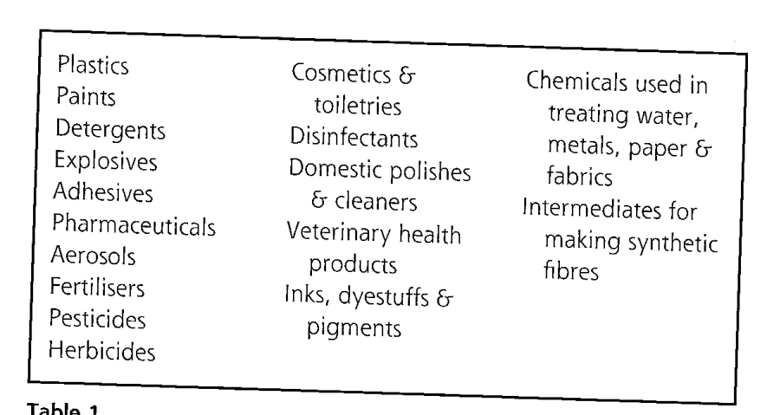
A feedstock is a reactant that other products are synthesised or extracted from.
A feedstock is made from a raw material
e.g. Naphtha is the feedstock, it is cracked to produce ethene. The raw material is crude oil.

Slide 7
Principles of design
Industrial processes are designed to maximise profit and minimise the effect on the environment
There are 7 principles of the design process:
Availability of feedstocks
Cost of the feedstock
*Sustainability of the feedstock
Opportunities for recycling
Energy requirements
Marketability of by-products
Product yield (or atom economy)
*Sustainability means that the feedstock is not going to run out and that it can continue to be supplied in the long term with minimum effect on the environment

Slide 8
Chemical manufacturing can use batch or continuous processes
Batch: raw materials are mixed together and allowed to react. The product is removed.
Continuous: reactants are fed in one end and the products removed in a continuous flow.
Process chosen to maximise economic efficiency.

Slide 9
Batch versus Continuous
manufacturing in the Chemical Industry
Batch
Continuous
For
OK for up to 100
OK for over 1000 tonnes per
tonnes per annum
.
annum
.
More v
ersatile
.
Good for fast single step
Good for multi
-
step
processes
.
reactions
.
Easy to automate
.
Against
Contamination
of
Capital cos
t
is high
.
product is more
Less flexible
.
likely.
Need to run at full capacity
At times, no product
to make a profit.
is made.
(Not in use)
Safety
more
of
an
issue
.

Slide 10
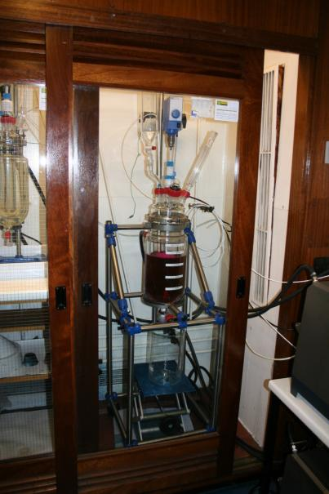
Batch – Drug development

Slide 11
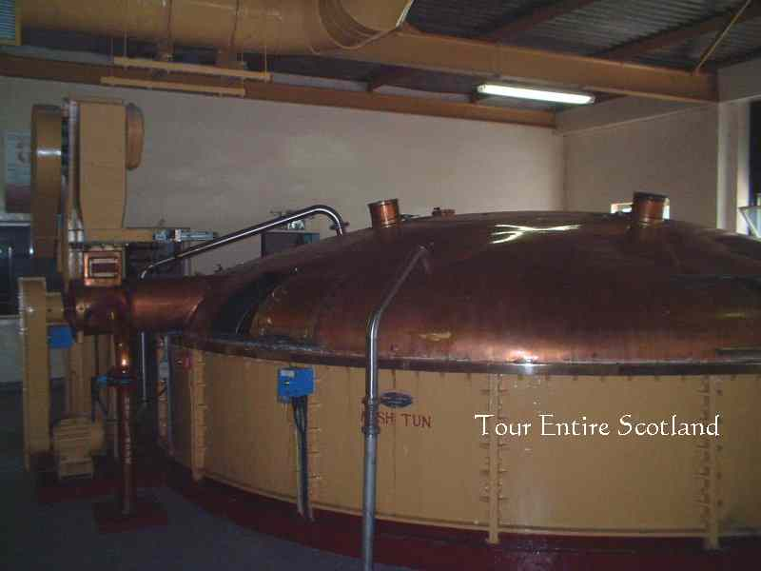
Batch – whisky production

Slide 12
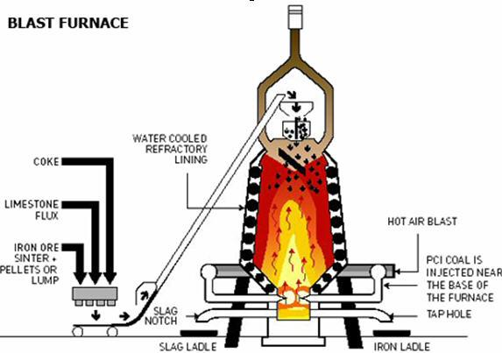
Continuous - Blast furnace

Slide 13
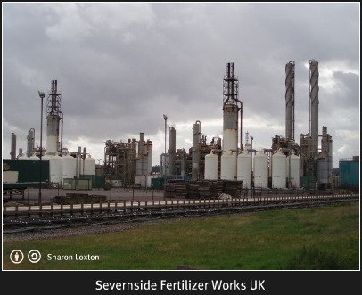
Continuous process – Haber process

Slide 14
Fertiliser Industry
Haber Process
Ammonia is manufactured from N₂ and H₂. The nitrogen is available from the raw material, air.
The other feedstock for the manufacture of NH₃ is hydrogen which is usually produced from steam reforming of methane.
Recycled gases
Natural
gas
CH₄ (g)
AIR
N₂
alkali
H₂O(g)
Water
H₂
N₂(g) +
H₂ (g)
Catalyst
Catalyst
Catalyst
heat
Stage 1
Stage 2
Stage 3
CO₂ removed

Slide 15
Sulphuric Acid Industry
Sulphuric acid is manufactured by the Contact Process.
Waste gases
98% acid
oleum
S
Sulphur
Stage 2
Oxygen
Stage 3
O₂(g)
Air
SO₂(g)
burner
Catalytic
Converter
Cat=V₂O₅
SO₃(g)
absorber
(In 90%
H₂SO₄)
heat
feedstock
Stage 1
water
H₂SO₄
Mixture to
dilute the acid

Slide 16
Economic Aspects
Operating Conditions; the conditions under which a chemical process operates are chosen to maximise
economic efficiency.
Raising the temperature may increase the rate of a reaction but it will increase energy costs so may not be economic.
Increasing the pressure may make more product but will mean using stronger reaction vessels and more powerful compressors and therefore not economic.

Slide 17
Manufacturing costs have to take into account
Capital costs
Fixed costs
Variable costs
Cost of building plant
Research and development
Depreciation of plant
Labour
Land purchase
Same if 1 tonne or 1000 tonnes
Raw materials and energy
Packaging
Can the by-products be sold?
Cost of waste disposal
Energy bills
Related to output

Slide 18
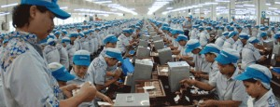
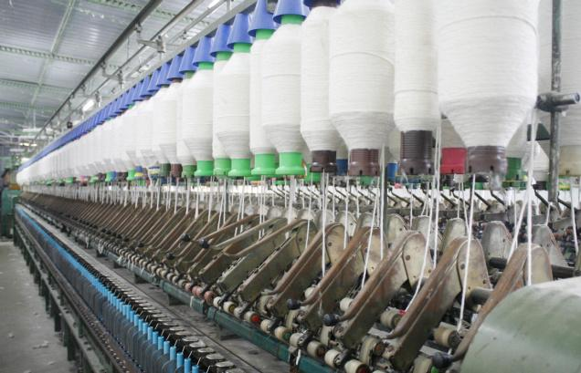
The UK chemical industry is, by and large, capital rather than labour intensive.
Labour intensive is when there is a workforce and therefore wages have to be paid.

Slide 19
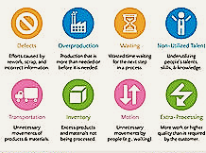
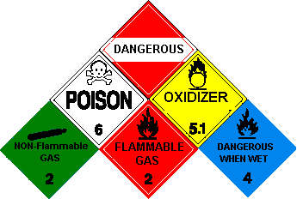
Environmental considerations include:
minimising waste;
avoiding the use or production of toxic substances;
designing products which will biodegrade if appropriate.
Reduce levels of discharge of harmful chemicals.

Slide 20
Efficient use of energy is significant to cut costs and recycling of feedstocks is often used.
Location of plant is key. Next to the sea if raw materials coming from abroad.
Location of chemical plants are historical and practical. Next to oil refinery for easy access to feedstock
Safety issues are important

