Slide 1
Equilibrium
*Reversible reactions may reach equilibrium instead of completely converting reactants to products.
*Dynamic equilibrium is defined in terms of reaction rates and concentrations of reactant and product

Slide 2

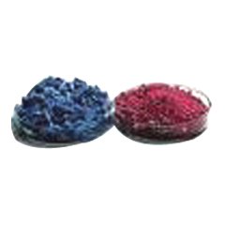
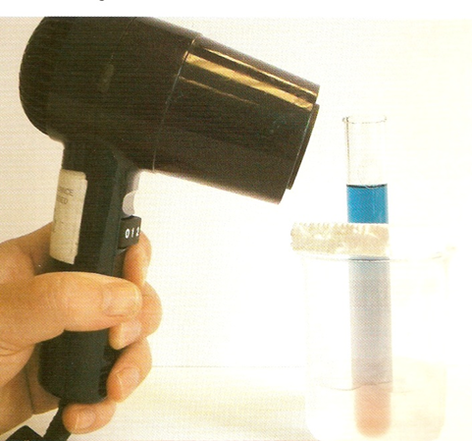
Reversible reaction (Nat5).
A reversible reaction is a reaction that can go both forwards and backwards
+6H₂O
CoCl₂ CoCl₂.6H₂O
Blue
- 6H₂O
Pink

Slide 3

Dynamic equilibrium
Reactants
Products
e.g. - hydrogen and iodine reacting to form hydrogen iodide.
H_{2(g)} + I_{2(g)} 2HI_{(g)}
The equilibrium can be arrived at from different starting points.

Slide 4
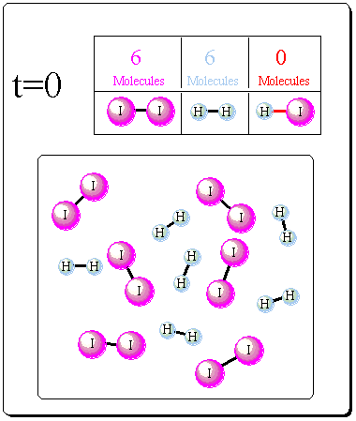
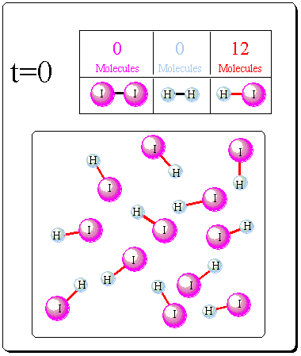
H₂ + I₂ 2HI
2HI H₂ + I₂
The position of an equilibrium does not depend on the starting position.

Slide 5
Dynamic equilibrium
A reversible reaction is said to be at Dynamic equilibrium when:
Rate of the forward reaction =
Rate of the reverse reaction
Rules for (dynamic) equilibrium:
The concentration of reactants and products remains constant.
The concentrations are not usually equal
The reaction has not stopped
Note: equilibrium is reached in a closed system. This means no substances are added or removed.

Slide 6
Reversible Reactions
e.g.
Carboxylic acid + alcohol ester + water
reversible reaction
At the beginning of the reaction:
Acid + alcohol react to produce ester and water
As the reaction proceeds:
acid + alcohol producing ester + water
ester + water producing acid + alcohol
Eventually:
Rate of ester, water produced =
Rate of acid, alcohol produced

Slide 7
Position of equilibrium
In a Concentration vs Time graph, the amounts of substances become constant at equilibrium:
concentration
products
reactants
time
Equilibrium
At equilibrium the concentration of products and reactants remains constant.

Slide 8
Example
Ethanoic acid + methanol methylethanoate + water
When equilibrium is reached
33% reactants 67% products
Equilibrium is said to lie to the right hand side (R.H.S.)

Slide 9



Equilibrium Reaction Rate Graphs
concentration
Equilibrium lies to L.H.S.
Time
Equilibrium
Reactants
Products

Slide 10
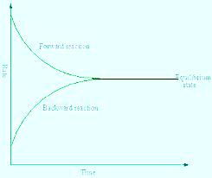
In a Rate vs Time graph, that the forward rate is large at first but steadily decreases, while the reverse rate starts at zero and steadily increases, until both rates are equal at equilibrium:
Equilibrium constant
Forward
Rate
equilibrium
Backward
Time

Slide 11
Altering Equilibrium Position
*Chemists alter the position of equilibrium to increase product yield, by changing factors such as;
concentration,
pressure,
Temperature.
*The use of a catalyst ensures the same equilibrium is reached more quickly but does not increase product yeild. A catalyst has no effect on the position of equilibrium

Slide 12
Altering the Position of Equilibrium
e.g.
A + B C
Rules:
Equilibrium moves right;
More products (C) are produced
Equilibrium moves left;
More reactants (A,B) are produced

Slide 13
Equilibrium
A reversible reaction can reach equilibrium in a closed system.
N₂ + 3H₂ 2NH₃
then it can remain at equilibrium forever unless the reaction conditions are altered.
The effects of any changes are stated in
Le Chatelier’s Principle:

Slide 14
Le Chatelier's Principle
If a chemical system at equilibrium experiences a change in total pressure, temperature or concentration, the position of equilibrium will shift to reduce the effects of the imposed change”.

Slide 15
1.Concentration may alter the position of equilibrium

Slide 16
Changing Concentration
Carboxylic acid + alcohol ester + water
INCREASE CONCENTRATION of any REACTANT:
Equilibrium moves to the right
INCREASE CONCENTRATION of any PRODUCT:
Equilibrium moves to the left
Opposite will apply:
DECREASE CONCENTRATION of PRODUCTS:
Equilibrium moves to the right
(and vice versa)

Slide 17
Increasing by addition of a substance.
OR
Decreasing by removal of a substance
by precipitation (data book page 21)
or by neutralisation (H⁺ /OH⁻)

Slide 18
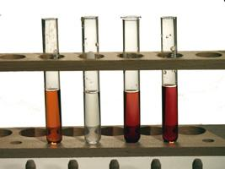
Concentration and equilibrium
Experiment 1
To 1 test tubes add 5cm³ iron (III) chloride. Iron (III) ions are yellow.
2.Add potassium thiocyanate solution until the solution goes red i.e. iron thiocyanate ions form.
3.Dilute this solution with water to make up to 100ml. Divide between 6 test tubes
equation:
Fe ³⁺ + CNS ⁻ [FeCNS]²⁺
yellow (colourless) red
The equilibrium position now lies in the middle, roughly equal amounts of both coloured ions are present.

Slide 19
Test Tube | Ions added | Observations | Reason
1. | Control
2. | Fe ³⁺
3. | CNS –
4. | K⁺Cl⁻
5. | Ag⁺NO₃⁻
6. | NaOH
Darker red
Darker red
Turns yellow
Goes colourless

Slide 20
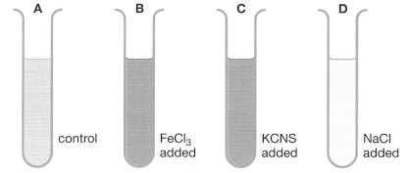
1. Add Fe ³⁺ ions
Add a few drops of iron (III) chloride.
What happens?
Higher Chemistry Eric Alan and John Harris
Fe ³⁺ + CNS ⁻ ⇄ [FeCNS]²⁺
yellow red
Test tube B
Fe ³⁺ ions are added. The equilibrium moves to use them up, favouring the forward reaction.
The equilibrium moves right and the solution becomes deeper red.

Slide 21
2. Add CNS ⁻ ions
Add a few drops of Potassium thiocyanate.
What happens?
Higher Chemistry Eric Alan and John Harris
Fe ³⁺ + CNS ⁻ ⇄ [FeCNS]²⁺
yellow red
Test tube C
CNS⁻ ions are added.
The equilibrium moves to remove these, favouring the forward reaction.
The equilibrium moves right and the solution becomes more red

Slide 22
3. Add K⁺Cl⁻ ions
Add a few drops of Potassium chloride.
What happens?
Higher Chemistry Eric Alan and John Harris
Fe ³⁺ + CNS ⁻ ⇄ [FeCNS]²⁺
yellow red
Test tube D
Fe ³⁺ ions are removed by the addition of K⁺Cl⁻
The equilibrium moves to replace this, favouring the reverse reaction
The equilibrium moves left and the solution becomes yellow.

Slide 23
4. Add AgNO₃ ions
Add a few drops of silver nitrate.
What happens?
Higher Chemistry Eric Alan and John Harris
Fe ³⁺ + CNS ⁻ ⇄ [FeCNS]²⁺
yellow red
Addition of AgNO₃
(This forms a precipitate with CNS, thus removing CNS)
The equilibrium moves left and the solution becomes colourless

Slide 24
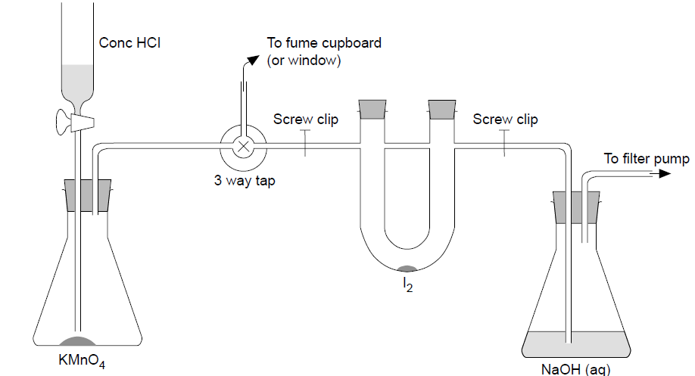

ICl + Cl₂ ICl₃ brown liquid yellow solid
Experiment 2

Slide 25
ICl + Cl₂ ICl₃ brown liquid yellow solid
Increasing the concentration of a chemical will cause the equilibrium to shift to use up the chemical.
Increasing the concentration of chlorine will cause the equilibrium to move to use up the chlorine.
The forward reaction uses up the chlorine so the equilibrium moves to the right producing more yellow solid and less brown liquid.

Slide 26
ICl + Cl₂ ICl₃
brown liquid yellow solid
Decreasing the concentration of a chemical will cause the equilibrium to shift to replace the chemical.
Decrease the concentration of chlorine and equilibrium will move to replace the chlorine.
Equilibrium will move to the left (reverse reaction) producing more brown liquid and less yellow solid.

Slide 27
Examples:
Carboxylic acid + alcohol ester + water
1.
Acid added:
Ester removed:
Water added:
2. Br₂ + C₂H₄ C₂H₄Br₂
Ethene added:
Sodium added (reacts with bromine);
3. H₂O H⁺ + OH⁻
Water removed:
Magnesium added (reacts with acid):

Slide 28
2.Temperature may alter the position of equilibrium

Slide 29
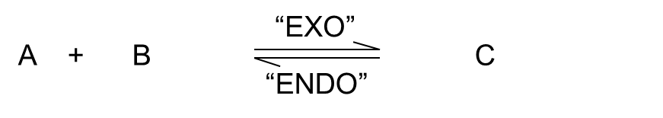
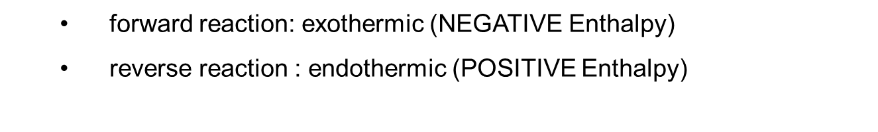
Remember Le Chatelier's principle states:
The equilibrium will move to undo any change imposed upon it.
Heating a reversible reaction at equilibrium shifts the reaction in the direction of the ENDOTHERMIC REACTION (more A + B produced)
Cooling a reversible reaction at equilibrium shifts the reaction in the direction of the EXOTHERMIC REACTION (more product C produced)

Slide 30
Exothermic reaction
A + B C + D + Energy -ΔH
Add heat -The reverse reaction (endo) absorbs heat. → equilibrium moves to the left.
The new equilibrium mixture contains more A and B
Conc product
Low temp
High temp - favours reactants so less product formed.
faster
In an exothermic reaction; increasing temperature shifts equilibrium to the left.

Slide 31
Endothermic reaction
Energy + A + B C + D +ΔH
Forward reaction is endothermic
Increasing temperature shifts equilibrium to the right.
Conc product
High temp- favours rhs so more product formed.
Low temp
faster

Slide 32
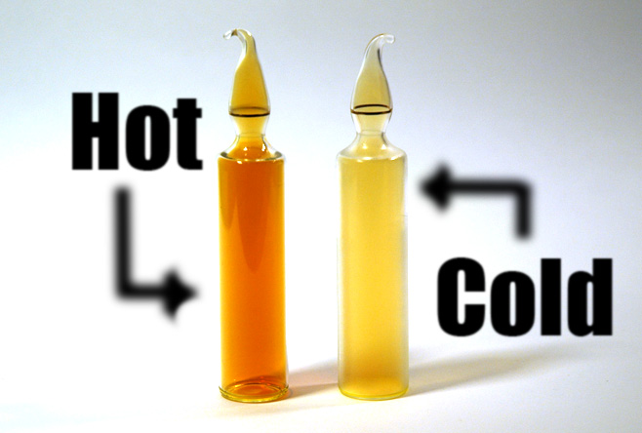
Experiment
N₂O₄ 2NO₂ ΔH +ve
dinitrogen tetraoxide nitrogen dioxide
(colourless) (dark brown)

Slide 33
N₂O₄ 2NO₂ ΔH +ve
dinitrogen tetraoxide nitrogen dioxide
(colourless) (dark brown)
Increasing the temperature
Equilibrium moves to lower the temperature.
The forward reaction takes in energy so the equilibrium moves to the right Producing more NO₂ , so the colour becomes darker.
Decreasing the temperature
Equilibrium moves to raise the temperature.
The reverse reaction gives out energy so the equilibrium moves to the left producing more N₂O_{4.} The colour becomes lighter.

Slide 34
3.Pressure may alter the position of equilibrium

Slide 35
The pressure exerted by a gas is caused by the freely moving molecules bombarding the walls of the container.
An increase in the number of molecules results in an increase in pressure, assuming the size of the container is kept constant.
The system can reduce the pressure by reacting in such a way as to produce fewer molecules.

Slide 36
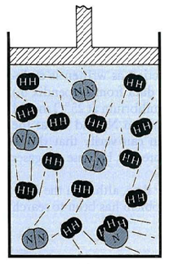
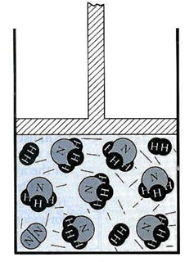
Changing Pressure
N₂ _{(g)} + 3 H₂ _{(g)} 2 NH₃ _{(g)}
1 volume
3 volumes
2 volumes
4 volumes
Increase Pressure
Volume decreases
FOR GASES, an increase in pressure will cause the equilibrium to counteract this effect so shift to the side of lower volume to reduce the pressure.
High pressures favour the side with less gas molecules.

Slide 37
Increase pressure: volume decreases
Equilibrium moves to side with lowest volume (right)
more NH₃ produced
Decrease pressure: volume increases
Equilibrium moves to side with largest volume (left)
More N₂, H₂ produced
Note:
2 A _{(g)} + B _{(g)} 4 C _{(s)} + D _{(g)} + 3 E _{(aq)}
Reactants have largest volume
Gases occupy much more space than solids or liquids

Slide 38
“EXO”
Ex1.
Br_{2 (l)} + H₂O _{(l)} 2 H⁺ _{(aq)} + Br⁻ _{(aq)} + BrO⁻ _{(aq)}
“ENDO”
Addition of bromine:
Increase temperature:
Addition of acid:
“ENDO”
Ex2. C₂H_{4 (g)} + H₂O _{(g)} C₂H₅OH _{(l)}
Remove ethanol:
Decrease pressure:
Decrease temperature:

Slide 39
Q. According to Le Chatelier how will increasing the pressure effect the following reaction:
N₂O₄ ⇄ 2NO₂
colourless brown
1 mole, so fewer particles 2 moles
lowers the pressure
A. According to Le Chatelier, the position of equilibrium will move in such a way as to counteract the change.
That means that the position of equilibrium will move so that the pressure is reduced again. This favours the side with the fewer gas molecules (which is N₂O₄).

Slide 40
4. Catalysts
A catalyst would increase the rate of the forward reaction and the reverse reaction, therefore: dynamic equilibrium will be achieved quicker, However
A catalyst has NO EFFECT on the position of equilibrium.

Slide 41
Summary
Variable Action Effect on position of Equilibrium
Concentration increase
decrease
Temperature increase
decrease
Pressure increase
decrease
moves to opposite side
moves to same side
moves in ENDOTHERMIC direction
moves in EXOTHERMIC direction
moves to side with lowest volume of gas
moves to side with highest volume of gas
No effect though equlibrium more rapidly attained
Catalyst

Slide 42


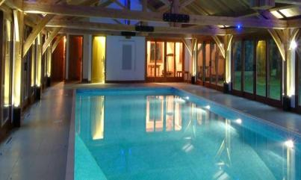
Effect of chemicals not present in the equilibrium
Dissolving chlorine in water produces the hypochlorite ion, ClO⁻, which has a bleaching effect.
Cl₂ + H₂O ⇄ 2H ⁺ + ClO⁻ + Cl⁻

Slide 43
Effect of neutralisation
Cl₂ + H₂O 2H ⁺ + ClO⁻ + Cl⁻
Adding an alkali will remove hydrogen ions from the equilibrium which will move to the right to replace them
The bleaching effect will be increased.

Slide 44
Effect of precipitation
Cl₂ + H₂O 2H ⁺ + ClO⁻ + Cl⁻
Adding silver nitrate will remove chloride ions from the equilibrium as the precipitate silver nitrate is formed.
The equilibrium will move to the right to replace them so the bleaching effect will be increased.

Slide 45
Effect of acid
Cl₂ + H₂O 2H ⁺ + ClO⁻ + Cl⁻
Adding an acid causes the equilibrium to move to use up H+ ions. The equilibrium moves to the left producing more toxic Cl₂
This can be fatal and accidents caused by mixing bleach and acid are not unusual.

Slide 46
Equilibrium and Industry
The laws of equilibrium are used by industrial chemists to increase the yield of products.
e.g
The Haber Process:
“EXO”
N_{2 (g)} + H₂ _{(g)} NH₃ _{(g)}
3
2
“ENDO”
Ammonia

Slide 47
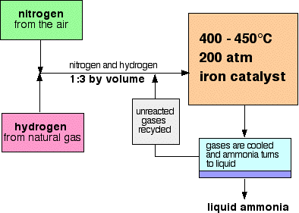

Slide 48
Ammonia (NH₃) is manufactured in the Haber process.
Feedstocks are:
1. Nitrogen from the air
2. Hydrogen from natural gas
Reaction conditions:
Catalyst: Iron
Temperature:450°C
Pressure:200 atmospheres

Slide 49
The reaction is reversible, so as well as nitrogen reacting with hydrogen to make ammonia, the ammonia also breaks back down again into nitrogen and hydrogen.
In most industrial situations a continuous process is used. This means that equilibrium which requires a closed system is never achieved.

Slide 50
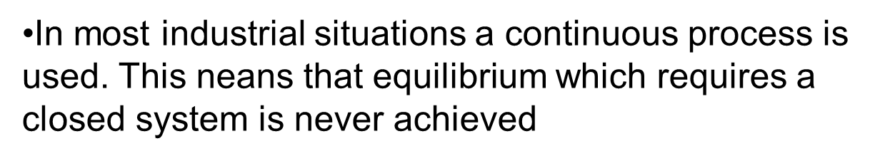
The above process is carried out in industry:
at a specific pressure
at a specific temperature
unreacted reactants are recycled continuously
products are removed continuously
a catalyst is used

Slide 51

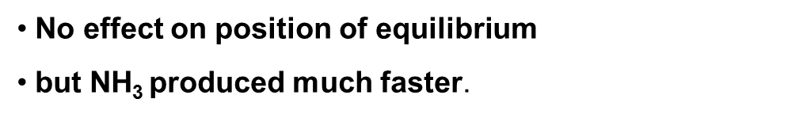
“EXO”
N_{2 (g)} + H₂ _{(g)} NH₃ _{(g)}
3
2
“ENDO”
Reaction conditions
High Pressure:
2.Low Temperature:
3.Recycle unused N₂, H₂:
4.Remove NH₃:
Equilibrium will move to the right (less volume)
More Ammonia (product)
Equilibrium will move to the right (Exothermic)
More Ammonia
Equilibrium will move to the right
(increased concentration of reactants)
More Ammonia
Equilibrium will move to the right
(decreased concentration of products)
More Ammonia

Slide 52
Economic Aspects
Industry is geared to make as much profit as possible so sometimes the process conditions are altered for economical reasons:
Low Temperatures:
Although this favours more product the reaction may be too slow and not economical.
Therefore moderate temperature used
2. High Pressure:
Although this favours more product the equipment required for dealing with high pressure will be too expensive.
Therefore moderate pressures will be used
3. Reaction completion:
Due to the removal of product continuously the reaction is never allowed to reach equilibrium

Slide 53
The Haber Process and equilibrium
If the flow rate is adjusted so that the gases spend x time in the reactor, more ammonia is produced per day at the higher temperature, despite the lower yield at equilibrium
Tonnes of
ammonia
200 ºC
400 ºC
time

Slide 54
The contact process involves a process to make H₂SO₄ (sulphuric acid)
2SO_{2(g)} + O_{2(g)} ⇋ 2SO_{3(g)} ΔH =-197kjmol⁻¹
What would the effect of raising the temperature have on
The rate of reaction
Yield of SO₃
Faster because collision theory shows that an increase in temperature will allow more reactant molecule to have minimum kinetic energy
Yield of SO₃ will decrease as high temperature favours endothermic reaction as system adjusts to remove heat.

