Slide 1
Chemical analysis as part of Quality Control
How are analytical chemistry techniques such as chromatography and volumetric analysis used to control the quality of products produced in an industrial process. in an industrial process

Slide 2
Chemical Analysis

Slide 3
Chemical analysis
Analysis is very important in industry for quality control purposes
Checking for contaminants
Checking the level of product e.g alcohol in whisky, aspirin in tablets etc
https://www.youtube.com/watch?feature=player_embedded&v=orh5qrzyLQA

Slide 4
Analysis
Analysis is widely carried out for a range of applications. A few examples are:
1. Soil analysis.
2. Samples of blood, urine etc. in health.
3. Water purification analysis.
4. Swimming pools etc.
5. Environmental health.

Slide 5
Redox titrations
Volumetric titration
Identify how solution concentrations can be accurately determined in volumetric titrations
Notes:
5

Slide 6
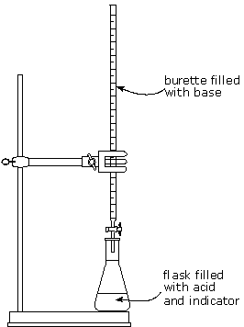
Titrations (Revision )
This is the technique used to calculate the exact concentration of a solution.
Titrations are repeated until CONCORDANT results are obtained
The end-point is the point at which the reaction is just complete.
An indicator is a substance which changes colour at the end-point. Some substances are self indicating e.g. potassium permanganate

Slide 7
Results:
First titration = 26.0 cm³
Second titration = 24.4 cm³
Third titration = 24.3 cm³
Rough result
Concordant results
Average of concordant results.
Volume
=
24.35 cm³
From the volume result obtained we can then go on to calculate:
number of moles
mass of substance dissolved
concentration of solution

Slide 8
Volumetric analysis involves using a solution of accurately known concentration in a quantitative reaction to determine the concentration of another substance.

Slide 9
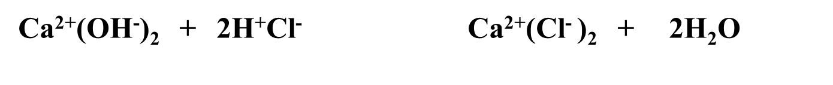
Acid / Base Titrations
Ex1. 25cm³ of 0.5 mol l⁻¹ hydrochloric acid was neutralised by 38 cm³ of calcium hydroxide.
What was the concentration of the alkali?
Step1: Write a balanced equation
Step 2. calculate number of moles using mole triangle:
2moles HCl
1mole Ca(OH)₂
Ca(OH)₂ : n =
c =
v =
HCl : n =
c =
v =
?
?
0.5
?
0.025
0.038
n = 0.5 x 0.025
n = 0.0125 moles of HCl

Slide 10
Step2. Calculate the number of moles of the other reactant using mole ratios from the balanced equation:
Ca(OH)₂ : 2 HCl
1 mole
:
:
2 moles
n
:
0.0125
n =
0.0125 moles
2
= 0.00625 moles of Ca(OH)₂

Slide 11
Step3. Use mole triangle to calculate concentration:
c = n/v
= 0.00625 / 0.038
c = 0.16 moll⁻¹

Slide 12
Example 2
H₂SO₄ + 2NaOH → Na₂SO₄ + 2H₂O
20 cm³ of sodium hydroxide solution was neutralised by 15cm³ of
0.1mol l⁻¹ sulphuric acid.
Calculate the concentration of the sodium hydroxide solution.
0.15 mol l⁻¹
Notes:
12

Slide 13
More examples to try
1) What volume of sulphuric acid, concentration 2 mol l⁻¹ is required to neutralise 25cm³ of KOH, concentration 4 mol l⁻¹?
2) If 50cm³ of KOH solution is neutralised by 17.8cm³ of H₂SO₄ (2 mol l⁻¹), what is the concentration of the alkali?
3) What volume of HCl, concentration 1.0 mol l⁻¹ is required to neutralise 100cm³ of NaOH solution concentration 0.5moll⁻¹?
25 cm³
1.42mol l⁻¹
50cm³
Notes:
13

Slide 14
Redox Titrations
Redox titrations involve solutions of reducing and
oxidising agents.
The volume of reactant solution required to complete the reaction is determined by titration.
In a redox titration precisely enough electrons have been removed to oxidise all of the reducing agent.
Notes:
14
14

Slide 15
Redox Titrations
  Exactly the same working as with acid/base titrations
Ex1. Iron(ii) chloride reacts with sodium dichromate as follows:
6 Fe ²⁺ +
Cr₂O₇²⁻
+ 14 H⁺
6 Fe ³⁺ +
2 Cr ³⁺ + 7 H₂O
a. Calculate the number of moles of iron(ii) ions which will react completely with 330cm³ of a 0.15 moll⁻¹ sodium dichromate solution.
b. Calculate the mass of Iron(ii) chloride required for the reaction.

Slide 16
A. Step 1:
Fe ²⁺
Cr₂O₇²⁻
n =
c =
v =
6 mole
1 mole
?
n =
c =
v =
?
?
0.33
?
0.15 moll⁻¹
n = 0.15 x 0.33
n = 0.05 moles of Cr₂O₇²⁻

Slide 17
Step 2: Calculate the number of moles of iron(ii) using mole ratios from the balanced equation:
6 Fe ²⁺ +
Cr₂O₇²⁻
+ 14 H⁺
6 Fe ³⁺ +
2 Cr ³⁺ + 7 H₂O
6 Fe ²⁺ : Cr₂O₇²⁻
6 moles
:
:
1 mole
n
:
0.05
n =
6 x 0.05
1
= 0.3 moles of iron(II)

Slide 18
B. Mass of Iron(ii) chloride:
m = n x gfm
m = 0.3 x 126.8
m = 38.04 g

Slide 19
Ex.2 25cm³ of H₂O₂ reacts with 16cm³ of 0.1 moll⁻¹ KMnO₄ _{(aq)} Calculate the concentration of the H₂O₂.
2 MnO₄⁻ +
5 H₂O₂
+ 6 H⁺
2 Mn ²⁺ +
5 O₂ + 8 H₂O
MnO₄⁻
n =
c =
v =
H₂O₂ n =
c =
v =
?
?
0.1 moll⁻¹
?
0.016 l
0.025 l
n = 0.1 x 0.016
n = 0.0016 moles of MnO₄⁻

Slide 20
2 MnO₄ : 5 H₂O₂
2 moles
:
:
5 moles
1
:
2.5
0.0016 :
n
n
= 0.0016 x 2.5
1
= 0.004 moles H₂O₂

Slide 21
H₂O₂ :
c = n/v
= 0.004 / 0.025
c = 0.16 moll⁻¹

Slide 22
Ex.3 The number of moles of carbon monoxide in a sample of air can be measured as follows:
Step 1 The carbon monoxide reacts with iodine(V) oxide, producing iodine.
5CO_{(g)} + I₂O_{5(s)} → I_{2(s)} + 5CO_{2 (g)}
Step 2 The iodine is then dissolved in potassium iodide solution and titrated against sodium thiosulphate solution.
I_{2(aq)} + 2S₂O₃^{2–}_{(aq)} → S₄O₆^{2–}_{(aq)} + 2I– _{(aq)}
If 50.4 cm³ of 0.10 mol l^{–1} sodium thiosulphate solution was used in a titration, calculate the number of moles of carbon monoxide in the sample of air.

Slide 23
Step 1:
Thiosulphate ion (sodium ion is spectator)
S₂O₃^{2–}
n =
c =
v =
?
0.1 moll⁻¹
0.0504 l
n
= 0.1 x 0.0504
= 5.04 x 10⁻³ moles S₂O₃^{2–}

Slide 24
Step 2:
2S₂O₃^{2–} : 5CO
2 moles : 5 moles
1 mole : 2.5 moles
5.04 x 10⁻³ : n
n = 2.5 x 5.04 x 10⁻³
= 0.013 moles CO

Slide 25
Example 4.
Permanganate ions react with hydrogen peroxide in acidic solution.
2MnO₄⁻ + 6H⁺ + 5H₂O₂ → 2Mn²⁺ + 8H₂O + 5O₂
25cm³ of hydrogen peroxide solution reacted with 16cm³ of permanganate solution, concentration 0.1 mol l^{-1.}
Calculate the concentration of the hydrogen peroxide solution.
0.16 mol l⁻¹
Notes:
25

Slide 26
Redox titration
Aim:
To find the mass of Vitamin C in a tablet
Redox Equations:
Balanced Redox Equation:

Slide 27
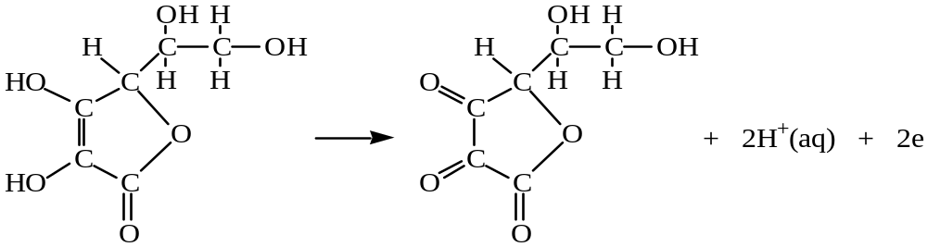
Background knowledge
Vitamin C (ascorbic acid) is an important component of our diet. In its absence the protein, collagen, cannot form fibres properly and this results in skin lesions and blood vessel fragility.
Although vitamin C occurs naturally in many fruits and vegetables many people take vitamin C tablets to supplement their intake.
Vitamin C can undergo a redox reaction with iodine in which the vitamin C is oxidised and the iodine molecules are reduced
I₂(aq) + 2e 2I⁻(aq)
Notes:
27

Slide 28
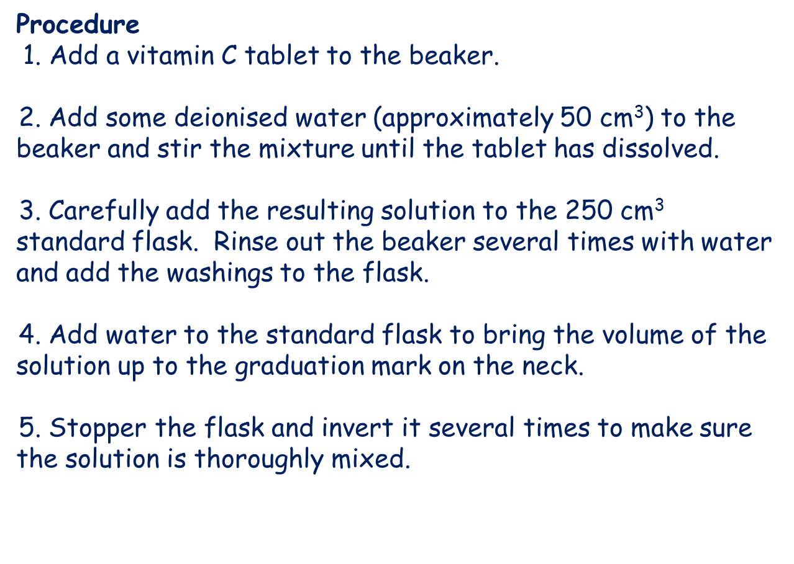

Slide 29
2. Titration:
Carefully fill the burette with iodine solution. Take the burette reading from the top of the meniscus as the dark colour makes it difficult to see.
Carefully pipette exactly 25 ml of vitamin C solution into the conical flask. Add a few drops of starch solution.
Titrate iodine solution into the conical flask until blue black colour appears.
Carry out a rough titration is first to give a rough equivalence-point (end-point), then repeat more accurately to give concordant results (+ or- 0.1ml).
The burette and pipette allow the volume to be measured accurately. Errors may occur in judging the endpoint/colour change
Results:
Calculations:
Conclusion:

Slide 30
Redox Titrations, Vitamin C
I₂ (aq) + 2e⁻ ➔ 2I ⁻ (aq)
reduction
C₆H₈O₆ ➔
C₆H₆O₆ + 2H⁺ (aq) + 2e⁻
oxidation
I₂ (aq) + C₆H₈O₆
➔
C₆H₆O₆ + 2H⁺ + 2I⁻ (aq)
Blue/Black (in the presence of starch)
colourless
Iodine : concentration is known (in the burette)
acts as an oxidising agent.
Vitamin C: unknown concentration (in the conical flask)
is a reducing agent.
Starch is added to show when the end-point is reached. When excess iodine is present starch will change from clear to blue black
Notes:
30
30

Slide 31
Calculation
Knowing the average volume and concentration of the iodine solution used in the redox titration and using n = c x v calculate the number of moles of iodine.
With the result from step (a) and the balanced equation for the redox reaction, we can work out the number of moles of vitamin C in 25 cm³ of the vitamin C solution.
This can be scaled up to find the number of moles of vitamin C in 250 cm³ of the vitamin C solution (multiply n by 10).
Your final answer in step (b) will be equal to the number of moles of vitamin C in the tablet. Using this result and the mass of one mole of vitamin C (g.f.m. = 176 g) we can work out the mass of vitamin C in the tablet using m = n x g.f.m.
Notes:
31

Slide 32
A standard solution is a solution of accurately known concentration.
To make a standard solution dissolve the calculated mass of solid in the minimum volume of water in a beaker, transfer to standard flask rinsing the beaker, dilute up to the graduated mark on the standard flask

Slide 33
Chromatography
Chromatography is one technique widely used for analysis.
Chromatography allows chemists to separate the components of a mixture.

Slide 34
Chromatography can be used to check the composition and purity of reactants and products
Learn how differences in size and polarity of molecules can be used to separate mixtures of reactants and products by chromatography to produce a chromatogram.

Slide 35
Variety is the spice of life!
Column Chromatography
Paper Chromatography
Ion Exchange
Thin Layer
Liquid Chromatography
Gas Chromatography
High Performance Liquid Chromatography
Gel Permeation

Slide 36
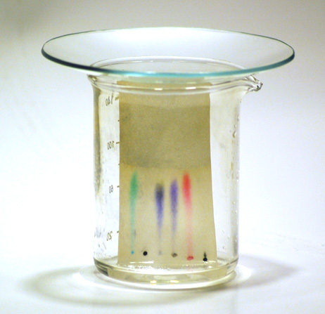
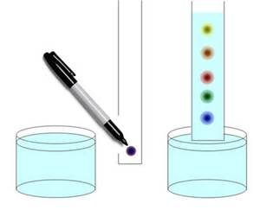
Paper chromatography
Paper chromatography is a technique is used to separate dyes and pigments from a colour solution or mixture.

Slide 37
Paper chromatography
Substances that are more soluble in the solvent travel further.
Separation occurs because molecules in the mixture have different polarities and/or size. If a polar solvent is used (ethanol) then molecules that are more polar rise up the paper faster than less polar molecules.
Larger molecules also take longer than smaller ones.
Substances that have more of an affinity for the paper travel less far.

Slide 38
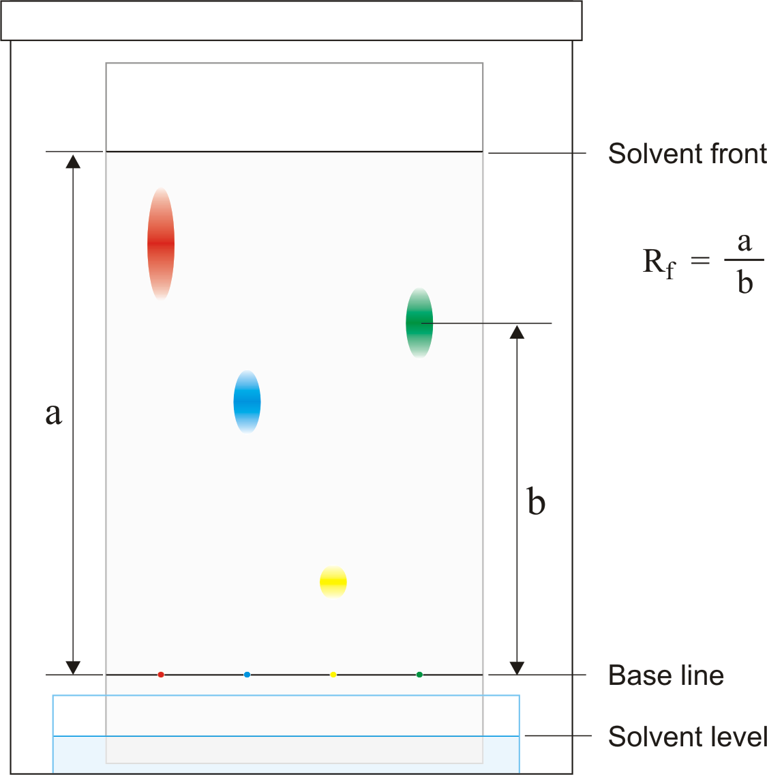
Key factor is the solubility of pigments in the solvent used (organic solvents like alcohol can be used).
As the solvent travels up the paper the pigments travel at different speeds thus the colours travel different distances.
Rf = b/a
Rate of Flow (Rf): is the ratio of distance covered by the dye and the distance covered by solvent.

Slide 39

Rf = b/a
Rf = b/a
Rf = b/a
Rf = b/a

Slide 40
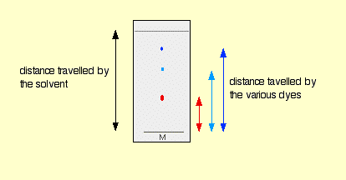

Calculating Rf.
The identity of a component can be indicated by the distance it has travelled.

Slide 41
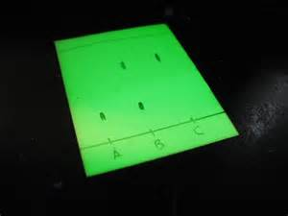
Thin Layer Chromatography
http://www.chemguide.co.uk/analysis/chromatography/thinlayer.html
Common use – cannabis analysis and amino acid separation.

Slide 42
Column chromatography
The column is packed with inert material
Substances take a different time to travel through the column according to their relative affinity for the solvent and the column material
Each substance has a specific retention time that can be used to identify it.

Slide 43
Column
http://chemsite.lsrhs.net/FlashMedia/html/columnChrom.html

Slide 44
Gas Liquid chromatography
Widely used in many industries.
Locally used by Diageo to test every mash produced by a distillery and every batch of alcohol produced.
Ensures the distillery is converting as much sugar to alcohol as possible.
Checks for impurities in the whisky.

Slide 45
Gas-Liquid Chromatography
An inert gas e.g. Helium or nitrogen is used in GLC
Heat is used to vaporises sample and is then carried by gas through the hot column

Slide 46
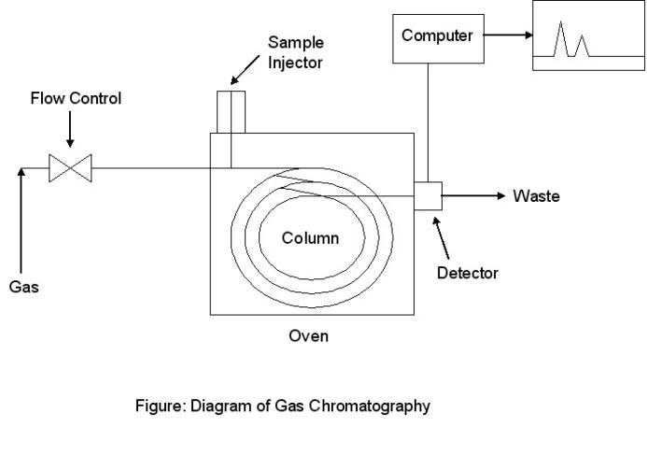
Gas Liquid chromatography

Slide 48
GLC cont
Rate of travel through column depends on relative affinity for gas or inert material
As substance emerged, analysed by detector, producing a graph.
Identification is by ‘retention time’
Height of peak indicates amount of substance

Slide 49
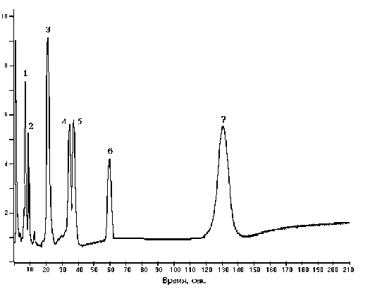
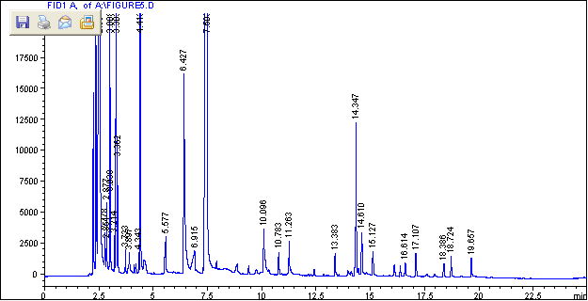
GC Chromatograms

Slide 50
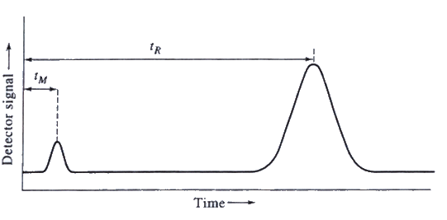
Retention Time
A typical chromatogram obtained from GLC and HPLC shows the quantity of the component on the y-axis and the retention time on the x-axis
The retention time is the time it takes to reach the detector

Slide 52
Identification
Retention times of known compounds have been recorded in a data base.
The Retention times of substances in the sample can then be compared to the data base and identified.

Slide 53
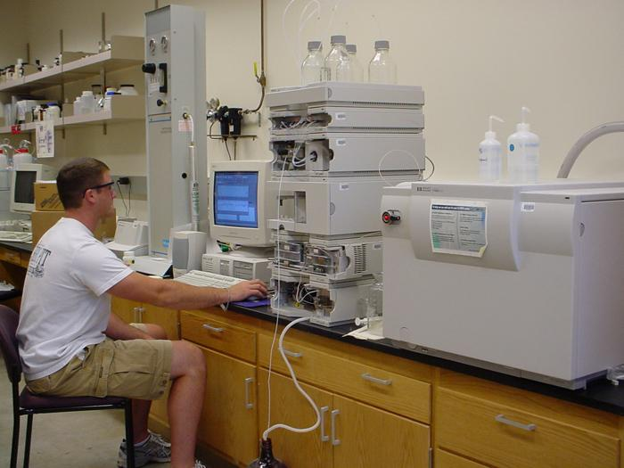
Chromatography is used to identify drugs in urine samples taken from athletes.
The mixture of liquids in the urine is injected, samples of known drugs have already been analysed.

Slide 54
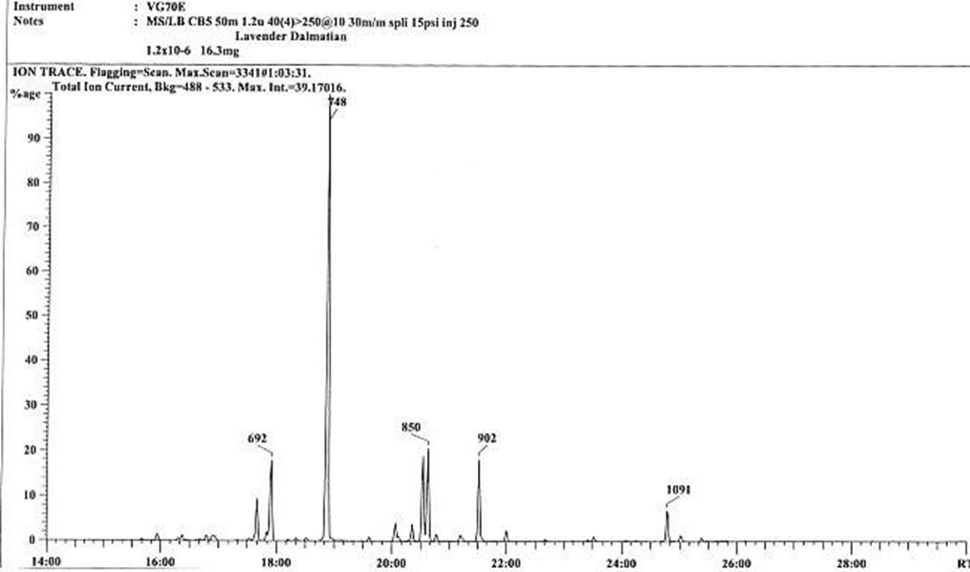
Steroid A takes 18mins 50 sec to pass through the chromatography machine.
Has the athlete tested below been using Steroid A?

Slide 55
Case Studies
http://media.rsc.org/Chemistry%20at%20the%20races/RSC%20Horseracing%20Part%205.pdf
(neigh chance!!)

Slide 56
http://media.rsc.org/Classic%20Chem%20Demos/CCD-24.pdf

Slide 57
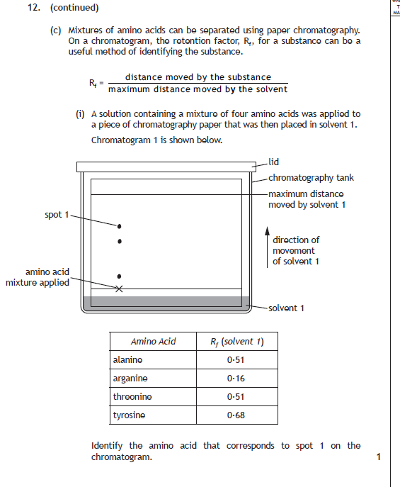

Slide 58
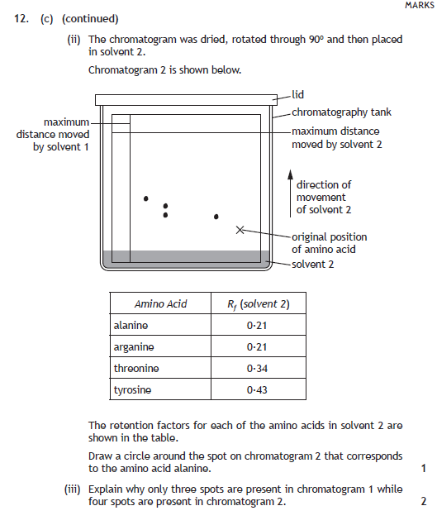

Slide 59
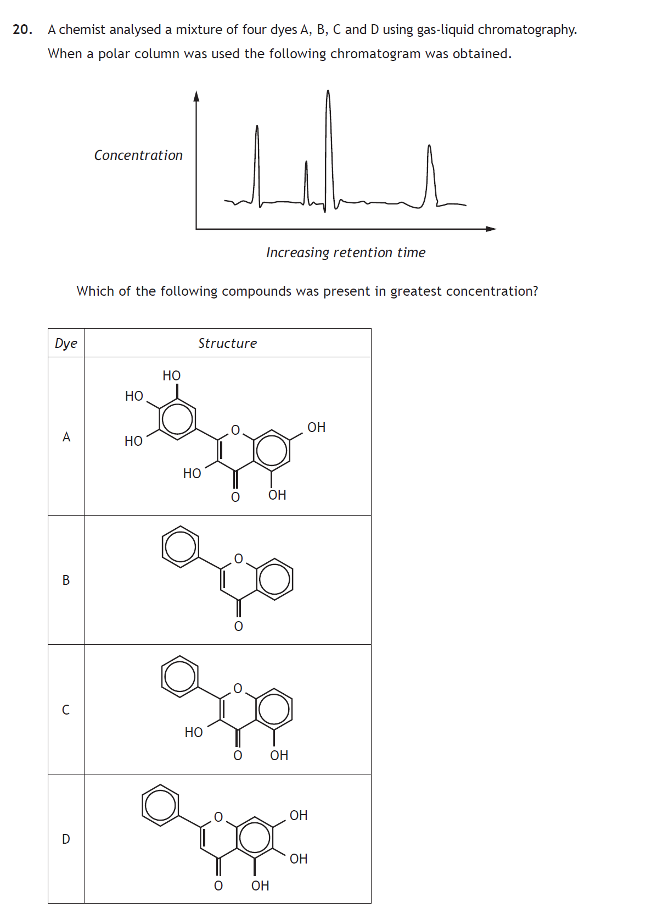

Slide 60
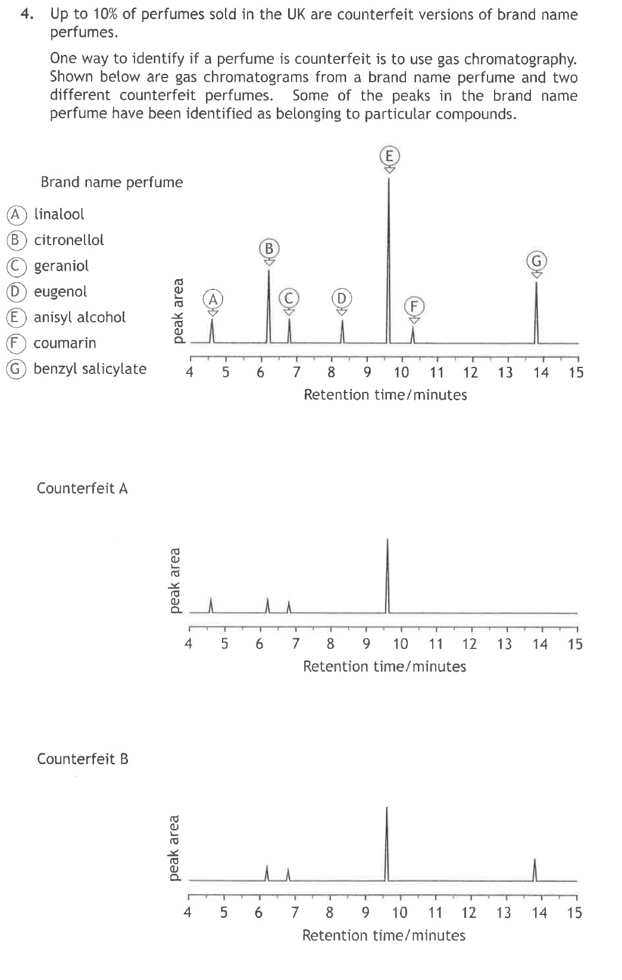

Slide 61
