Slide 1
Answers to Practice Test 2
Unit 1 Level C test

Slide 2
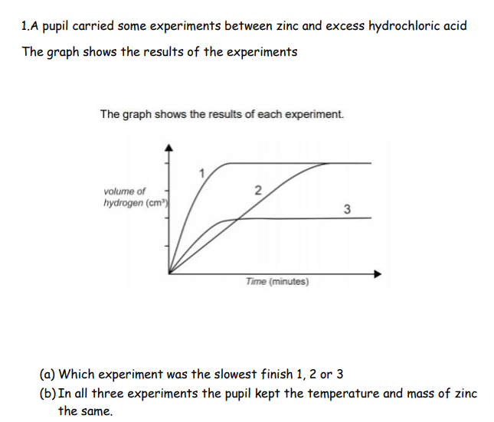

Exp 2
4g

Slide 3
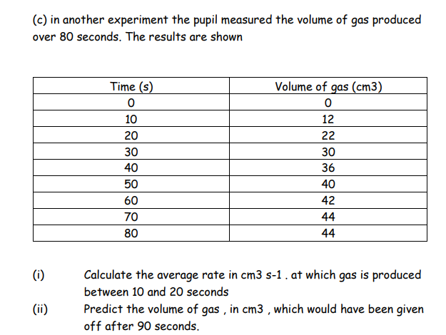
(a) 22-12
20-10
= 1
(b) 44

Slide 4
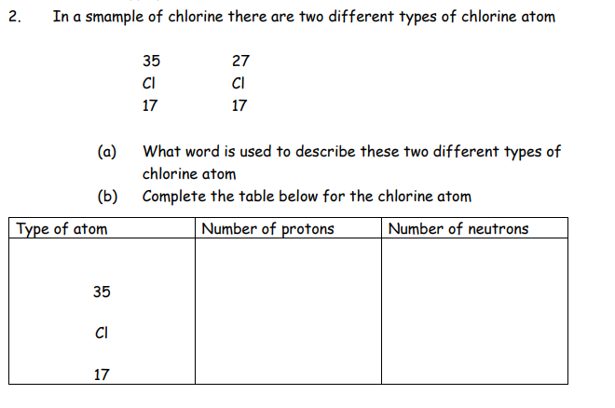
37
isotopes
35-17
= 18
17

Slide 5
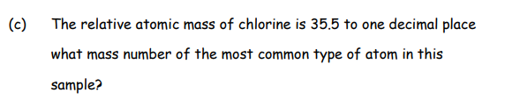
35

Slide 6
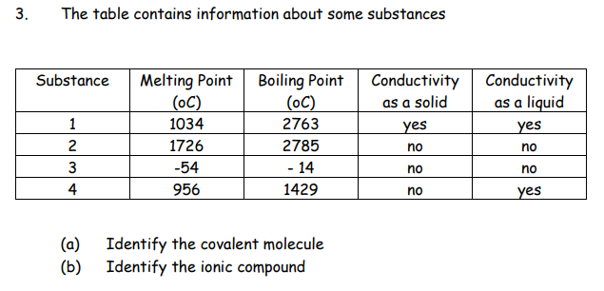
3
4

Slide 7
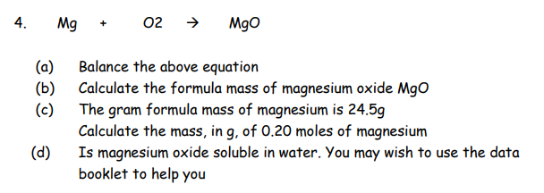

1/2
(a)
(b) 24.5 + 16 = 40.5g
1 mol 40.5 g
0.2 mol 40.5 x 0.2 = 8.1g
(d) insoluble

Slide 8
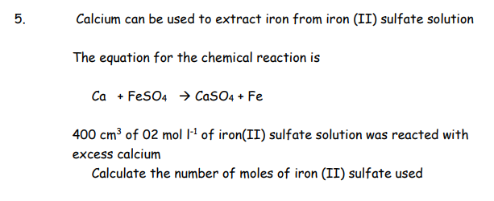
Moles = Concentration x volume
= 0.2 x 400
1000
= 0.08 mol

Slide 9
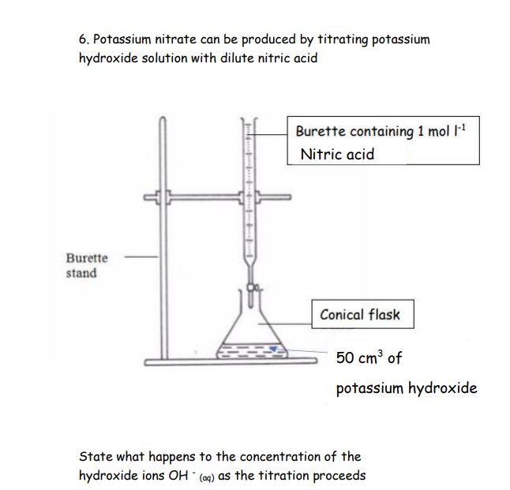
Concentration decreases

Slide 10
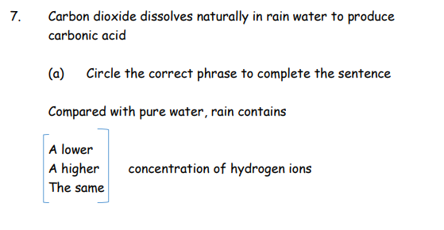

Slide 11
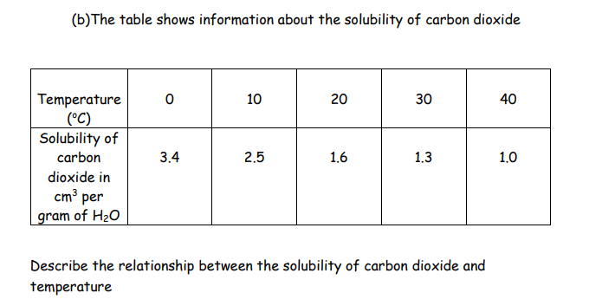
As the temperature INCREASES the solubility DECREASES

Slide 12
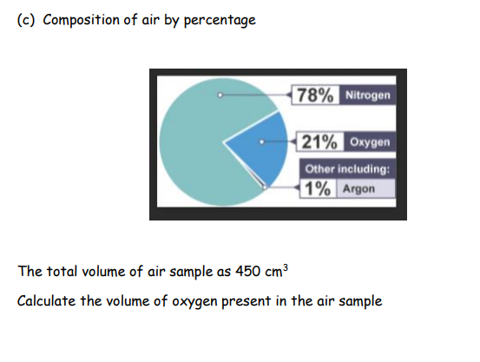
21% of 450
100% → 450
1% → 450
100
21% → 450 x 21
  100
  94.4 cm³

