Slide 1


National Biology: Langholm Academy

Slide 2


Taught by me….
Mrs G!
Hi everyone,
This presentation will give you some information about National level Biology.
If you have any questions, see me. I’ll be happy to answer as best I can.

Slide 3
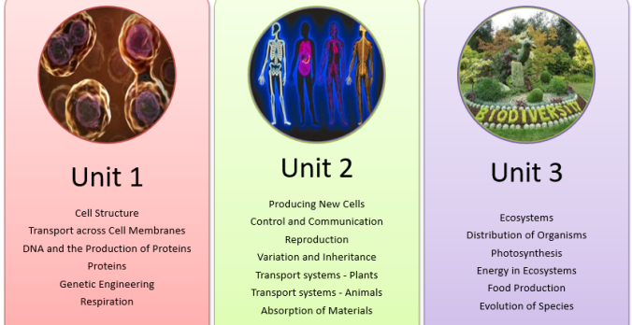
What will I study?
There are three Units.
In S3 Biology we will already cover most of Unit 3: Life on Earth.
Each Unit is divided into topics called Key Areas.

Slide 4




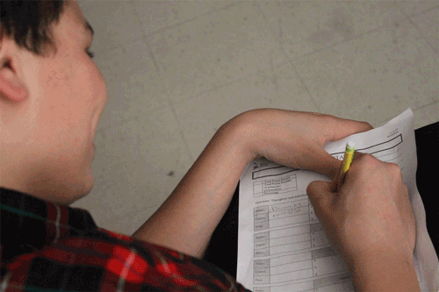
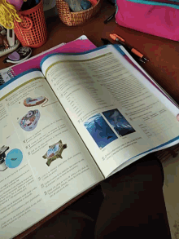
How will I be taught?
In a similar way to S1-3 Science/ Biology:
Notes taken from power point
Discussion
Experiments
Research tasks
Worksheets
Textbook work

Slide 5
How is National Biology assessed?
National 5
Unit Assessment
  Taken in class time
  1 assessment per unit
  Approx. 45 minutes each
Question paper (exam) in May 2022
  100 marks
  2½ hours
  80% of final grade
Assignment
  25 marks
  8 hours (including research, experiment and write-up)
  20% of final grade
  National 4 undertake Unit Assessments and an alternative to the assignment called an Added Value Unit. There is no final exam for National 4.

Slide 6
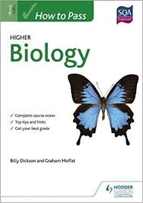

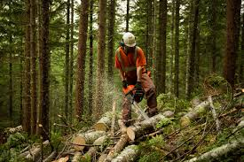
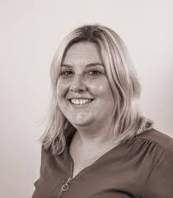
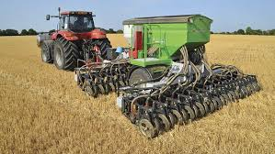
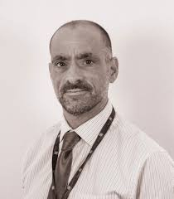
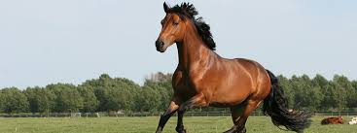

Progression

