Slide 1


S3 Biology: Langholm Academy

Slide 2


Taught by me….
Mrs G!
Hi everyone,
This presentation will give you some information about S3 Biology.
If you have any questions, see me. I’ll be happy to answer as best I can.

Slide 3

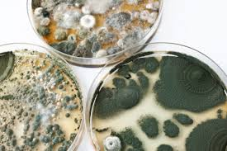
What will I study?
Remaining BGE outcomes: for most 3rd/4th level.
Genetics
Biotechnology

Slide 4




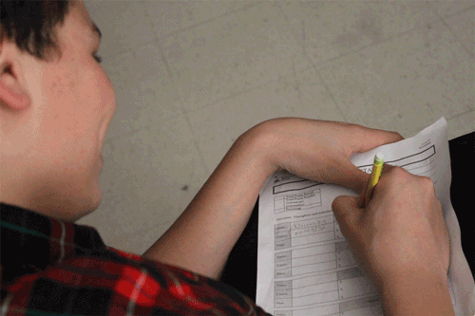
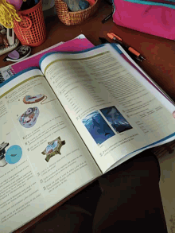
How will I be taught?
In a similar way to S2 Biology:
Notes taken from power point
Discussion
Experiments
Class Activities
Research tasks
Worksheets
Textbook work

Slide 5
How WILL I BE ASSESSED?
Homework
  Weekly
  Forms/Paper-based/Research task/Revision
Investigation
End of Unit Assessments
  Taken in class time
  2 assessments per unit
  Approx. 45 minutes each

Slide 6
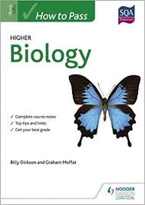

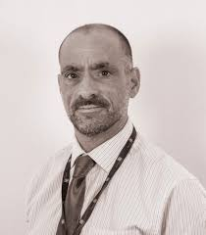
Progression
Performance in S1-3:
Consistently 4th level/steady progression culminating in 4th level – National 5
Consistently 3rd level/steady progression culminating in 3rd level – National 4
Not yet achieved 3rd level – National 3

