Slide 1


Higher Biology: Langholm Academy

Slide 2

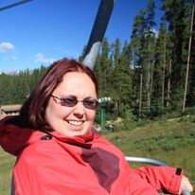
Taught by me….
Mrs G!
Hi everyone,
This presentation will give you some information about Higher level Biology.
If you have any questions, see me. I’ll be happy to answer as best I can.

Slide 3
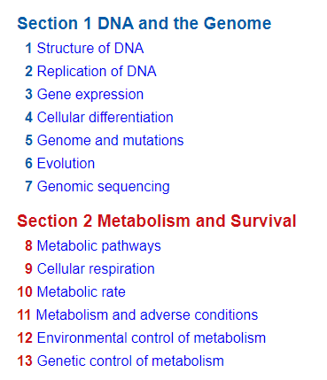
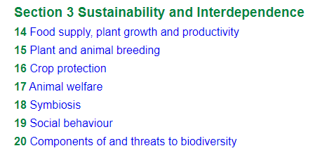
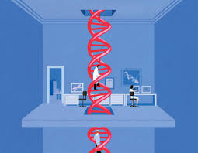
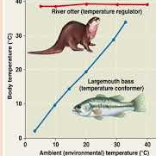
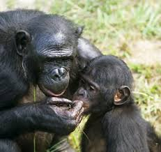
What will I study?
There are three Units.
These are completed in the order shown.
Each Unit is divided into Key Areas.

Slide 4




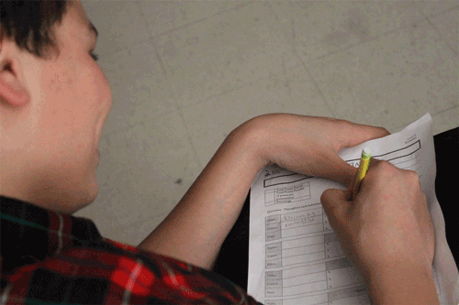
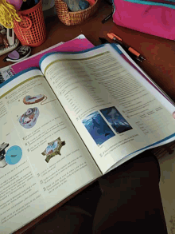
How will I be taught?
In a similar way to National 5 Biology:
Notes taken from power point
Discussion
Experiments
Research tasks
Worksheets
Textbook work

Slide 5
How is HIGHER Biology assessed?
End of Unit Assessments
  Taken in class time
  2 assessments per unit – 1 @ C-grade, 1 @ ABC-grade
  Approx. 45 minutes each
2 Question papers (exam) in May 2022
  Paper 1 – 25 marks, 40 mins
  Paper 2 – 95 marks, 2hrs 20mins
  80% of final grade
Assignment
  20 marks (scaled)
  8 hours (including research, experiment and write-up)
  20% of final grade

Slide 6
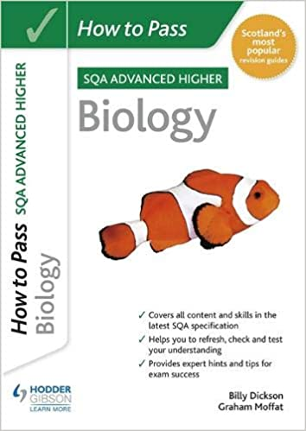
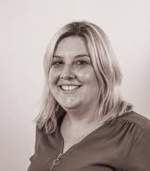
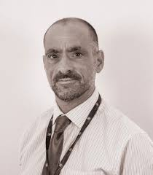
Progression – in school
Advanced Higher Biology
Higher Physics
Higher Chemistry

Slide 7



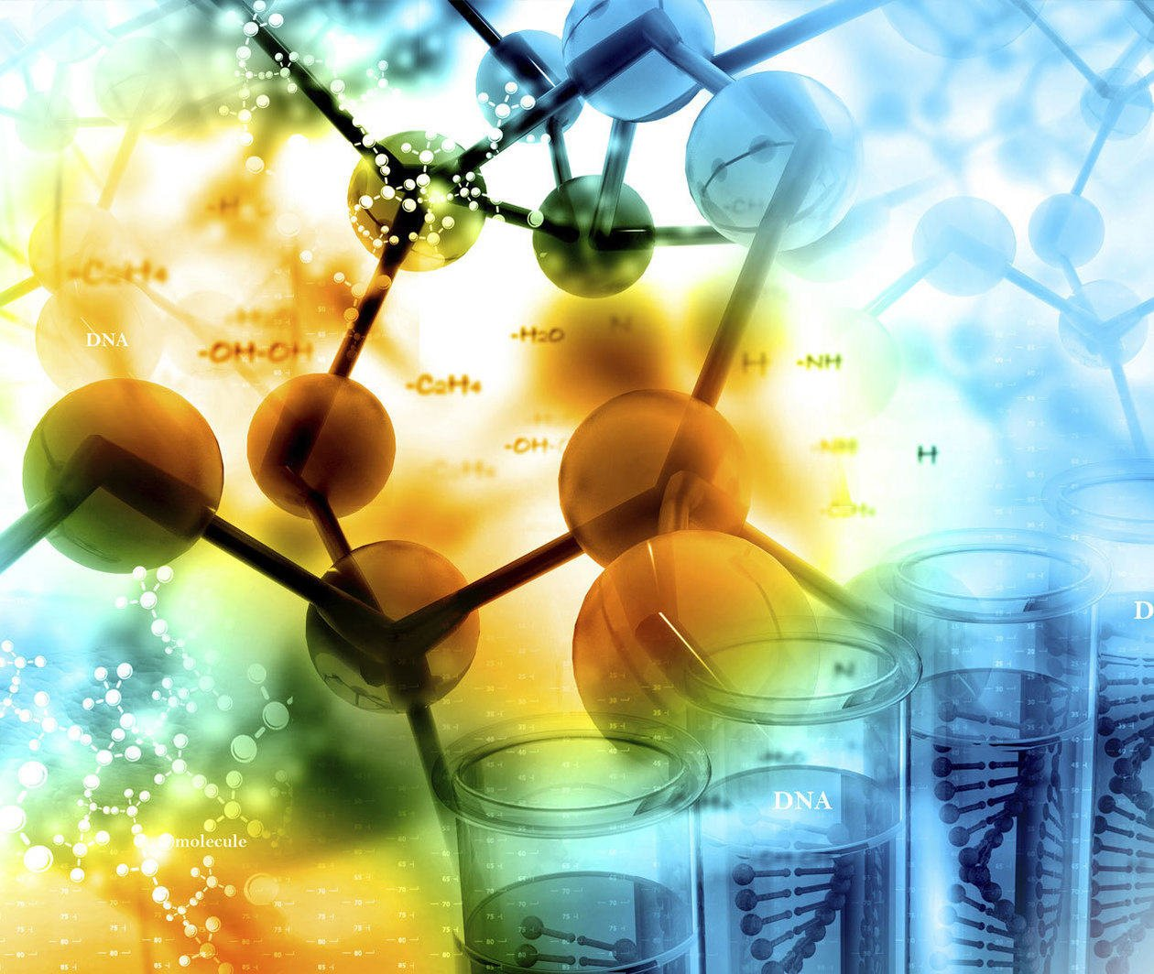




Progression – after school

