Slide 1
National 4/5
Practical Woodwork
SUBJECT INFORMATION

Slide 2
COURSE
CONTENT
COURSE PROGRESSION
The course is split up into 3 Units:
FLAT-FRAME CONSTRUCTION
CARCASE CONSTRUCTION
MACHINING AND FINISHING
Units are assessed as pass or fail by the school (following SQA external quality assurance to meet national standards).
TWO YEAR JOURNEY:
NATIONAL 4
NATIONAL 5
ONE YEAR JOURNEY:
NATIONAL 5
THERE IS NO PROGRESSION PAST NATIONAL 5 IN PRACTICAL WOODWORK AS THERE IS NOT A HIGHER WOODOWORKING QUALIFICATION.

Slide 3
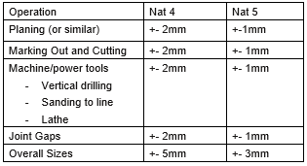
National 4 or National 5
The National 4 and National 5 Practical Woodwork run in the same class and is the same course.
The only difference is the accuracy to which you work. If you can work to 2mm accuracy you will sit the National 4 course or if you can work to 1mm accuracy you will sit the National 5 course.

Slide 4
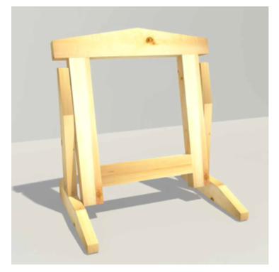
Unit 1- Flat Frame Construction
Unit 1 – Assessment Model
During this unit you will develop skills, knowledge and understanding in the use of woodworking tools and in making woodworking joints and assemblies commonly used in flat-frame joinery.
During the model you will be assessed on your accuracy or measuring and marking out, your accuracy on manufacturing and your accuracy of assembly.
To achieve National 4 all dimensions must be within 2mm.
To achieve National 5 all dimensions must be within 1mm.
This is a pass or fail assessment.
During this unit you will become familiar with the following joints:
National 4 and 5:
Mitre joint
Dowel Joint
Corner-Halving Joint
T-Halving
Through Mortise and Tenon
Stub Mortise and Tenon
Cross-Halving
National 5 ONLY
Corner Bridle
T-Bridle
Dovetail Halving
Haunched Mortise and Tenon

Slide 5
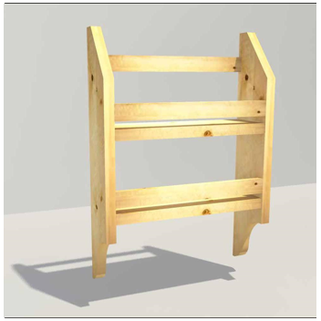
Unit 2- Carcase Construction
Unit 2 – Assessment Model
During this unit you will develop skills, knowledge and understanding in the use of woodworking tools and in making woodworking joints and assemblies commonly used in carcase construction.
This may include working with manufactures board, frames and panels.
During this unit you will become familiar with the following joints:
During the model you will be assessed on your accuracy or measuring and marking out, your accuracy on manufacturing and your accuracy of assembly.
To achieve National 4 all dimensions must be within 2mm.
To achieve National 5 all dimensions must be within 1mm.
This is a pass or fail assessment.
National 4 and 5:
Butt Joint
Corner Rebate Joint
Dowel Joint
Through Housing Joint
National 5 ONLY
Stopped Housing Joint

Slide 6
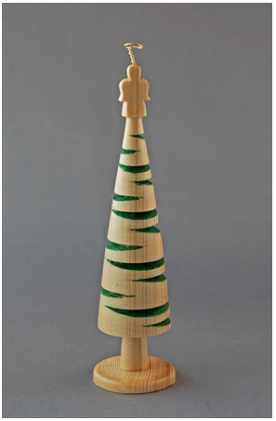
Unit 3- Machining and Finishing
Unit 3 – Assessment Model
During this unit you will develop skills, knowledge and understanding in using machine and power tools. You will also develop skills in a variety of woodworking surface preparations and finishing techniques.
During this unit you will become familiar with the following machine and power tools:
During the model you will be assessed on your accuracy or measuring and marking out, your accuracy on manufacturing and your accuracy of assembly.
To achieve National 4 all dimensions must be within 2mm.
To achieve National 5 all dimensions must be within 1mm.
This is a pass or fail assessment.
Machine Tools:
Wood turning Lathe
Belt Sander
Disc Sander
Pillar Drill
Mortise Machine
Power Tools:
Cordless Drill
Corded Drill
Belt Sander
Jig Saw
Surface Preparation Techniques:
Use of planes
Sanding
Abrasive types/grades
Surface Finishes:
Varnish
Stain
Wax
Oil

Slide 7
NATIONAL 4-
FINAL ASSESSMENT
1 COMPONENT
NATIONAL 5 – FINAL ASSESSMENT
2 COMPONENTS
Component 1 – Practical Assignment worth 70% of final grade.
This Assignment is issued by the SQA and is completed in class. This Assignment runs from January until March and is graded A-D.
Practical Assignment requires learners to produce a finished product in wood, with working drawings, a record of progress and an evaluation of the project.
The Added Value Unit is issued by the SQA and is completed in class. This Assignment runs from January until March and is graded as pass/fail.
The Added Value Unit (Practical Activity) will require learners to produce a finished product in wood, completing a record of progress and an evaluation of the project.
Component 2 – Theory Exam worth 30% of final grade.
This theory exam assesses knowledge of:
Tools and machines
Manufacturing techniques
Safe working procedures

