Slide 1
National 4/5 Graphic Communication
SUBJECT INFORMATION

Slide 2

Course content
NATIONAL 4 or
NATIONAL 5
The course is split up into 2 Units:
2D Graphic Communication
3D and Pictorial Graphic Communication
Units are assessed as pass or fail by the school (following SQA external quality assurance to meet national standards).
The National 4 and National 5 Graphic Communication Course run in the same class and is the same course.
The level at which you will be presented depends on three things;
The accuracy of you work
How independent you are at completing your work
The level of detail you put into your work
The graphics course concentrates of three main elements;
Preliminary Graphics (sketching and drawing)
Production Graphics ( Computer Aided Design)
Promotional Graphics (Desktop Publishing)
Course progression
THREE YEAR JOURNEY:
NATIONAL 4
NATIONAL 5
HIGHER
TWO YEAR JOURNEY:
NATIONAL 5
HIGHER

Slide 3
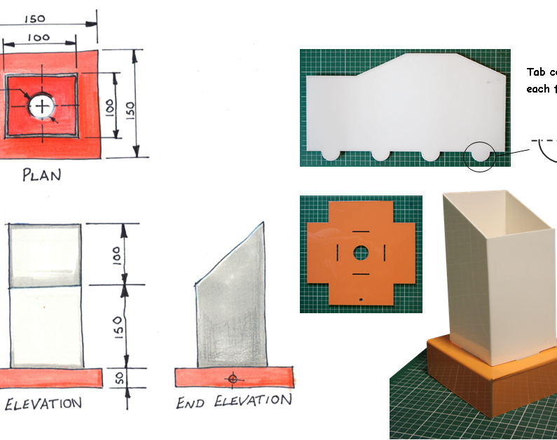
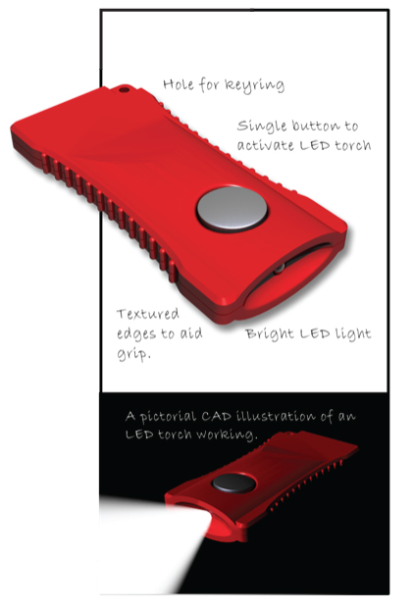
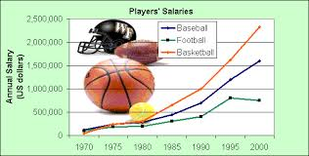
Unit 1 – 2D graphic communication
2D Unit – Assessment
The three assessment tasks will assess different elements of the course.
Each assessment task is a pass/fail.
The 2D unit looks at:
Producing and interpreting 2D sketches and drawings
    You will get a chance to work on the drawing boards to create manual drawings but will also be introduced to a variety of sketching techniques.
Producing preliminary 2D colour designs and illustrations for single-page promotional displays
    You will learn all about how to create effective promotional graphics such as posters and leaflets.
Creating 2D promotional graphic layouts
    You will get a chance to learn how to use Desktop Publishing Software to create posters and leaflets.

Slide 4
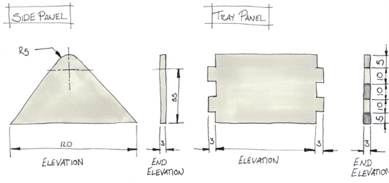
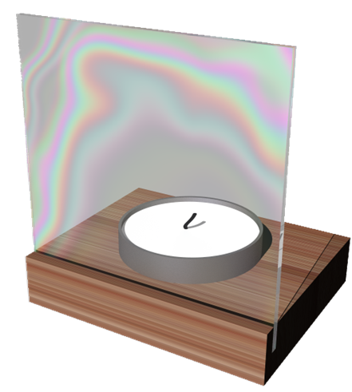
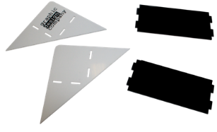
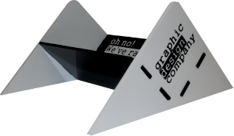
Unit 2 – 3D and Pictorial graphic Communication
The 3D unit looks at:
Producing and interpreting pictorial sketches, pictorial drawings and 3D models
    You will work on the drawing boards to create manual drawings but will also be working in Inventor to create 3D models.
Producing pictorial and 3D illustrations
    You will learn all about how to create effective 3D illustrations both on the computer and manually.
Creating pictorial or 3D promotional displays
    You will get a chance to learn how to use Inventor to incorporate a rendered 3D object into a promotional document.
3D Unit – Assessment
The two assessment tasks will assess different elements of the course.
Each assessment task is a pass/fail.

Slide 5
NATIONAL 4 –
FINAL ASSESSMENT
1 component
NATIONAL 5 –
FINAL ASSESSMENT
2 components
Component 1 – Practical Assignment worth 36% of final grade.
This Assignment is issued by the SQA and is completed in class. This Assignment is an 8 hour Assignment and runs during February and March in class. It is graded A-D by the SQA.
The final Assignment involves learners being given a brief to which they will respond, applying skills and knowledge gained from the Units.
The Added Value Unit is issued by the SQA and is completed in class. This Assignment runs through the month of March and is graded as pass/fail.
The Added Value Unit (Assignment) will involve learners being given a brief to which they will respond, applying skills and knowledge gained from the Units.
Component 2 – Theory exam worth 64% of the final grade.
This exam assesses all knowledge gained throughout the course and is a 2 hour assessment.

