Slide 1
Higher Graphic Communication
SUBJECT INFORMATION

Slide 2
Course content
The course is split up into 2 Units:
2D Graphic Communication
3D and Pictorial Graphic Communication
Units are assessed as pass or fail by the school (following SQA external quality assurance to meet national standards).

Slide 3
Higher graphics communication
The graphics course concentrates on three main skill and theory areas;
Preliminary Graphics (Sketching and Drawing)
Production Graphics ( Computer Aided Design)
Promotional Graphics (Desktop Publishing)

Slide 4
Unit 1 – 2D graphic communication
The 2D unit looks at
Produce and interpret 2D orthographic sketches and drawings
    You will learn all about British Standards in Graphic Communication and how to produce orthographic sketches of every day items.
Produce 2D computer-aided designed production drawings
    You will learn how to use CAD software to create 2D drawings.
Produce preliminary 2D designs and illustrations for a multi-page promotional document by
    You will learn how to create effective promotional documents (leaflets)
Creating multi-page 2D promotional publication and a project set of promotional publications
    You will get a chance to learn how to use Desktop Publishing Software to create posters and leaflets.

Slide 5
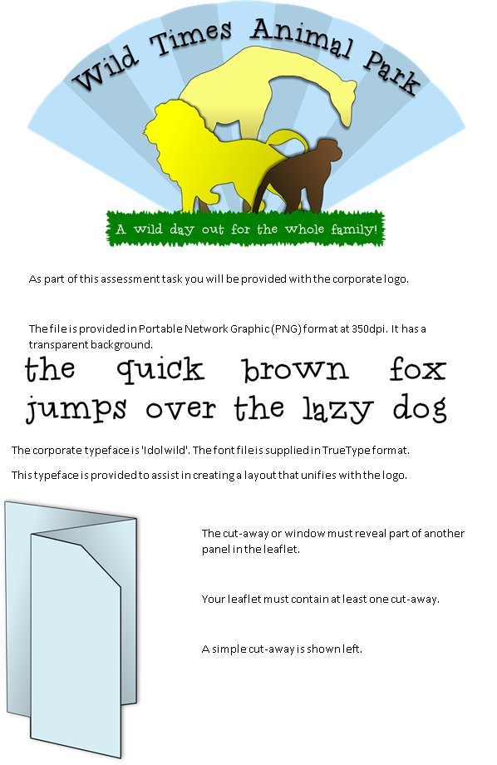
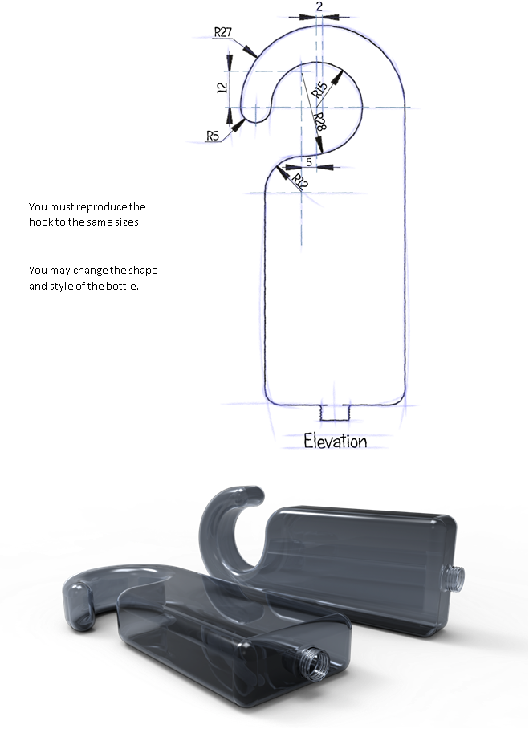
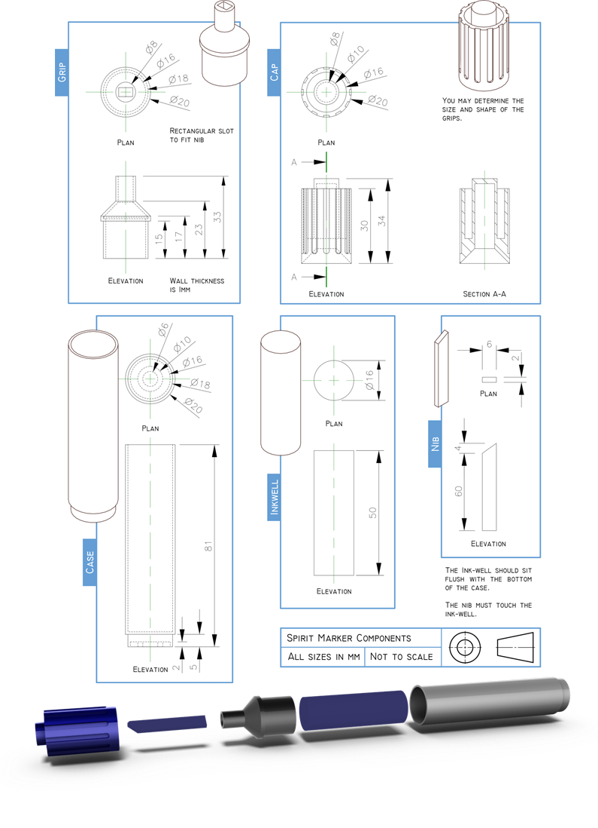
Unit 1 – 2D graphic communication
3 assessment tasks
The three assessment tasks will assess different elements of the course.
Each assessment task is a pass/fail.

Slide 6
Unit 2 – 3D and Pictorial graphic Communication
The 3D unit looks at:
Producing and interpret pictorial sketches and drawings
    You will learn all about British Standards in Graphic Communication and how to produce 3D drawings of every day objects.
Producing 3D computer-aided designed models and associated production drawings
    You will learn all about how to create effective 3D models and the working drawings to go with them.
Producing pictorial and 3D illustrations of everyday objects
    You will learn how to use Inventor to create realistic rendered objects.
Plan and produce promotional publications incorporating pictorial and/or 3D models
  You will get a chance to learn how to use Desktop Publishing software and Inventor to incorporate a rendered 3D object into a promotional document.

Slide 7
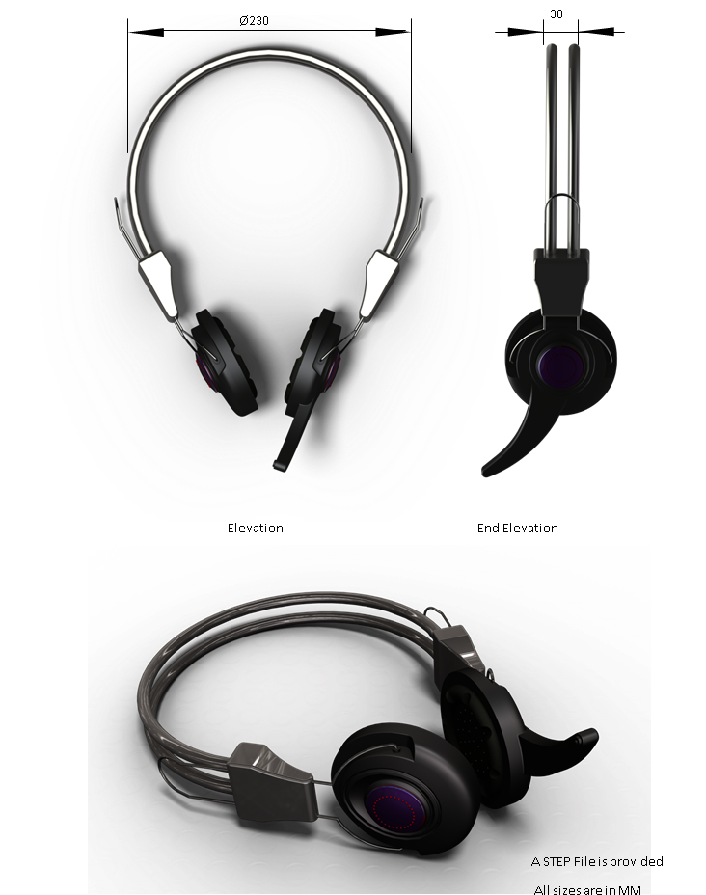
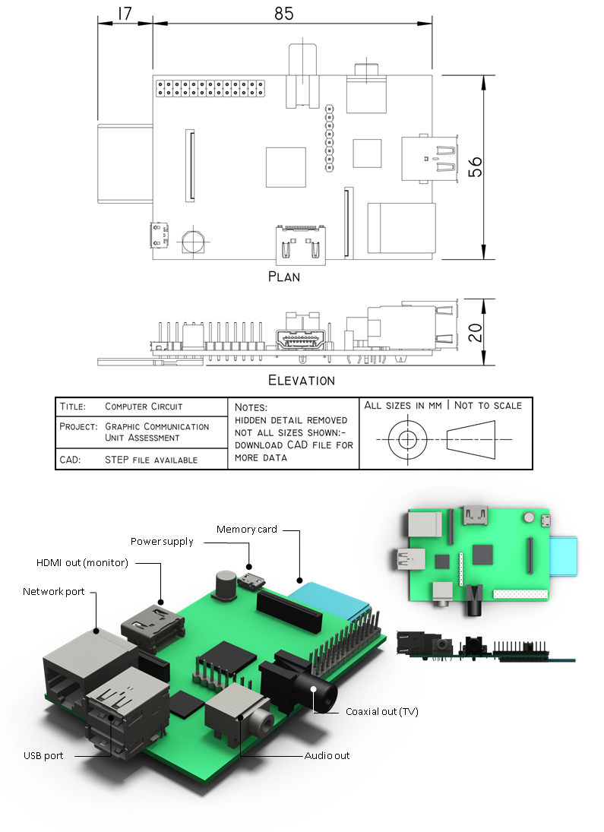
Unit 2 – 3D and pictorial graphic communication
2 assessment tasks
The two assessment tasks will assess different elements of the course.
Each assessment task is a pass/fail.

Slide 8
HIGHER– FINAL ASSESSMENT
- 2 components
Component 1 – Practical Assignment worth 36% of final grade.
This Assignment is issued by the SQA and is completed in class. This Assignment is an 8 hour Assignment and runs during February and March in class. It is graded A-D by the SQA.
The final Assignment involves learners being given a brief to which they will respond, applying skills and knowledge gained from the Units.
Component 2 – Theory exam worth 64% of the final grade.
This exam assesses all knowledge gained throughout the course and is a 2.5 hour assessment.

