Slide 1





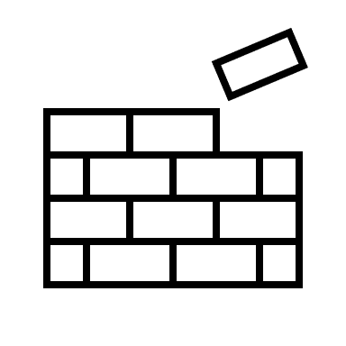


Progression in Craft, Design and Graphics
S1 Units of Work
One Point Perspective Sketching
Design & Make – Acrylic Key fob
Computer Aided Design
Design & Make – Wooden Tech Stand
S1
S2
S2 Units of Work
HIGHER ORDER THINKING SKILLS
Isometric Sketching
Design & Make – Towers of Hanoi
3D modelling
Desktop Publishing
These skills will be developed thoughout all the Technical Education courses:
S3 PCS Units of Work
Flat Frame Construction
Carcase Construction
Theory
S3 PCS
CREATING
Pupils will have the opportunities to design physical models, CAD models and advertisement documents
S2 Choices
EVALUATING
Pupils will have the opportunities to evaluate their own work and others work.
S3 GC
S3 Graphic Communication
Manual Graphics
Computer Aided Graphics
ANALYSING
Pupils will have the opportunities to look at information and pick out the relevant information.
N4/5
PWW
APPLYING
Pupils will be able to use their skills and knowleg independenly to solve different problems.
HigherGC
N4/5
GC
UNDERSTANDING
Pupils will be able to use their understanding to explain concepts in technical education.
PROGRESSION
Pupil will leave with an indepth knowledge of different elements of Technical Education which will allow them to progress onto careers such as: Engineering, Graphic Design, Construction, Animation, Architecture
REMEMBERING
Pupils will be able to list and explain terminology.

