Slide 1












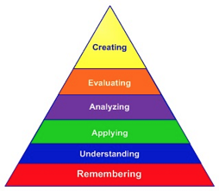








Progression in Biology (Langholm Academy)
Curriculum for Excellence
(CfE)
Environmental Biology
SCN 3-01a SCN 4-01a
SCN 4-12a
SCN 4-20b
Body Systems
SCN 3-12a SCN 4-12b
SCN 3-12b
SCN 3-13c
Reporduction in Animals
SCN 3-14a SCN 4-14a
SCN 4-14b
BGE
S1
S2
From
primary…
Reproduction in Plants
SCN 4-02a
SCN 4-14b
Biotechnology
SCN 3-13b SCN 4-13a
SCN 3-20a SCN 4-13b
SCN 3-20b SCN 4-13c
SCN 4-20a
OPTION
CHOICES
Cells
SCN 3-13a SCN 4-13a
Genetics
SCN 3-14b SCN 4-13c
SCN 3-20a SCN 4-14c
SCN 3-20b
Cellular Processes
SCN 3-02a SCN 4-02b
Thinking Skills
(Bloom’s Taxonomy)
S3
Enzymes
SCN 4-13b
OPTION
CHOICES
Senior Phase
National
Cell Biology
Multicellular Organisms
Life on Earth
Higher
DNA and the Genome
Metabolism and Survival
Sustainability and Interdependence
Advanced Higher
*Network East Partnership
Developing the Young Workforce (DYW)
S4/ 5/6
Personalised curriculum
Skills development
Relevant learning experiences
Positive destination
Responsibilite of All (RoA)
Inclusion

