Slide 1



2021/22 Report to Annual General Meeting
10 October 2022

Slide 2

Parent Council arrangements
One Cluster PC that covers Langholm Primary and Academy (through-school) and cluster-wide issues
Separate PC for Canonbie Primary as this is a separate school within the cluster

Slide 3
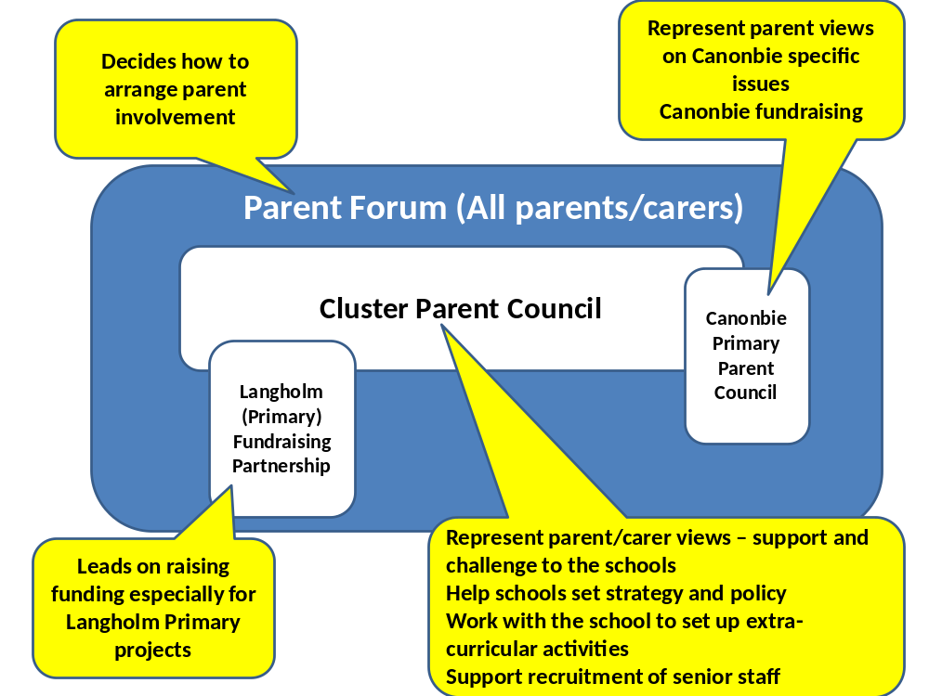

Slide 4
Role of Parent Council
Improve links between all parents and the school by reporting regularly to parents about the work of the Parent Council;
Discuss any issue that is of interest to parents, making sure that parents get the information they need in an accessible way and that the school staff gets feedback on parents’ views;
Provide feedback on school policies on issues of interest to parents;
Work jointly with the school to set up extra-curricular activities and after-school clubs;
Identify skills and knowledge among parents that can help the schools to perform their role;
Represent parents’ views to the education authority and others on those issues that are of concern to parents, pupils and staff;
Support the school and the fundraising group with preparing and submitting grant applications.
Be involved in the recruitment of new head teachers and other senior staff as appropriate.

Slide 5

A caveat…
Covid has yet again impacted on activity, with less face to face interaction possible and a degree of disengagement ongoing

Slide 6
Key areas of focus in 21/22
October 21: Quality standards, school improvement plan, primary assessment and attainment
December 21: Communications with Parent Forum

Slide 7
March 22: IT infrastructure – session with Digital Schools Manager
June 2022 – School Improvement Plan, SQA assessment framework, transition, policy matters raised by parents (including mobile phone policy, cover teachers, buddy scheme)

Slide 8
Challenges
Covid-19 has continued to challenge the ability of the Parent Council to act beyond meetings. In all honesty we as a parent body haven’t done that much in the last year
There remains a relatively small number of regular attendees at the Parent Council meetings. We still need to find ways of encouraging wider participation, including in leading specific pieces of work on behalf of the PC.
It remains challenging to make progress on a wide range of issues in the short and infrequent meetings that we generally have.

Slide 9
Office Holders 2021/22
Chair: Colin Cox
Vice Chair: Harry Stephens
Secretary: ad hoc
Treasurer: Tracy Little

Slide 10
Annual Accounts
Balance b/fwd |  | 396.36
Interest | 29/06/2021 | 0.06
 | 29/09/2021 | 0.05
 | 30/12/2022 | 0.05
 | 31/03/2022 | 0.07
Dumfries & Galloway | 06/12/2021 | 176.40
Balance c/fwd |  |  |  | 572.99
 |  | 572.99 |  | 572.99

